Slide 1
Unit-II: Mining Association and Supervised Learning
Classification and Regression
Regression: Linear Regression, Multiple Linear Regression, Logist Regression, Polynomial Regression,
Decision Trees: ID3, C4.5, CART.
Apriori Algorithm: Market basket analysis, Association Rules.
Neural Networks: Introduction, Perceptron, Multilayer Perceptron, Support vector machine.

Slide 2
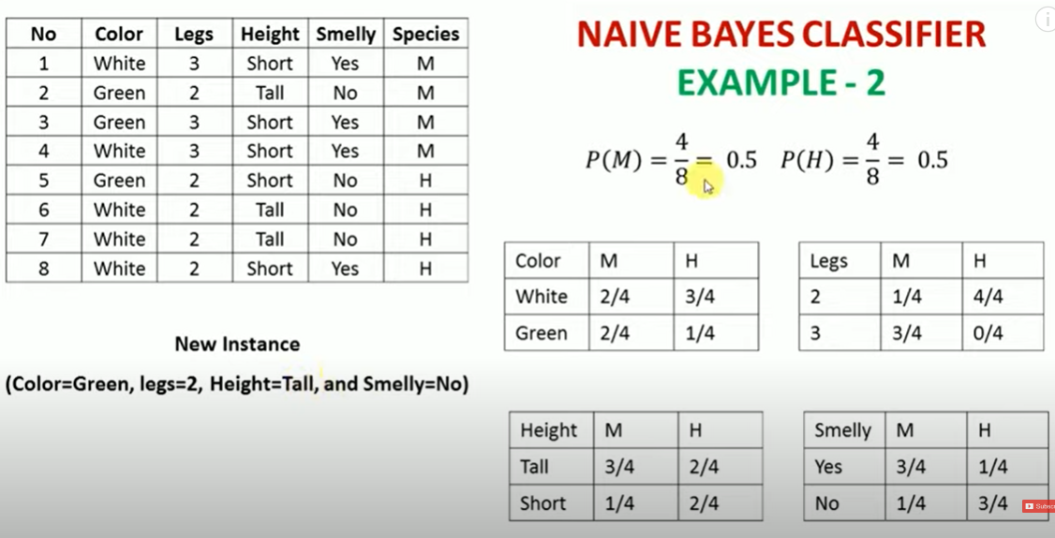
Unit-II: Mining Association and Supervised Learning

Slide 3
Regression vs. Classification in Machine Learning:
Supervised learning methods: It contains past data with labels which are then used for building the model.
Supervised learning problems can be further grouped into Regression and Classification problems.
Regression: The output variable to be predicted is continuous in nature, e.g. scores of a student, diamond prices, car prices, house prices etc.
Regression algorithms are used to predict the continuous values such as price, salary, age, etc.
Classification: The output variable to be predicted is categorical in nature, e.g. classifying incoming emails as spam or not spam, Yes or No, True or False, 0 or 1.
Classification algorithms are used to predict/Classify the discrete values such as Male or Female, True or False, Spam or Not Spam, etc.

Slide 4
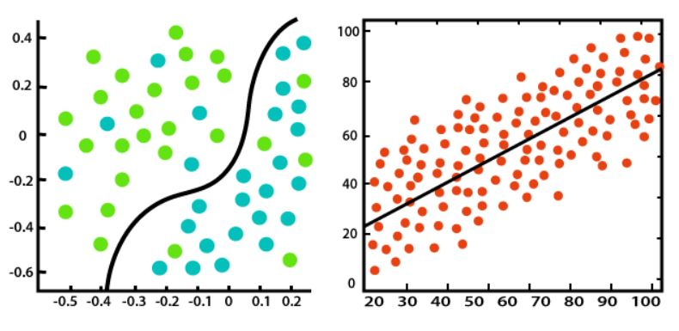
Regression vs. Classification in Machine Learning:

Slide 5
Regression vs. Classification in Machine Learning:
Regression Algorithm | Classification Algorithm
In Regression, the output variable must be of continuous nature or real value. | In Classification, the output variable must be a discrete value.
The task of the regression algorithm is to map the input value (x) with the continuous output variable(y). | The task of the classification algorithm is to map the input value(x) with the discrete output variable(y).
Regression Algorithms are used with continuous data. | Classification Algorithms are used with discrete data.
In Regression, we try to find the best fit line, which can predict the output more accurately. | In Classification, we try to find the decision boundary, which can divide the dataset into different classes.
Regression algorithms can be used to solve the regression problems such as Weather Prediction, House price prediction, etc. | Classification Algorithms can be used to solve classification problems such as Identification of spam emails, Speech Recognition, Identification of cancer cells, etc.
The regression Algorithm can be further divided into Linear and Non-linear Regression. | The Classification algorithms can be divided into Binary Classifier and Multi-class Classifier.

Slide 6
Which of the following is a regression task?
Predicting age of a person
Predicting nationality of a person
Predicting whether stock price of a company will increase tomorrow
Predicting whether a document is related to sighting of UFOs?
Solution : Predicting age of a person (because it is a real value, predicting nationality is categorical, whether stock price will increase is discrete-yes/no answer, predicting whether a document is related to UFO is again discrete- a yes/no answer).
Let’s take an example of linear regression. We have a Housing data set and we want to predict the price of the house.

Slide 7
Which of the following is/are classification problem(s)?
Predicting the gender of a person by his/her handwriting style
Predicting house price based on area.
Predicting whether monsoon will be normal next year.
Predict the number of copies a music album will be sold next month.

Slide 8
Terminologies Related to the Regression Analysis:
Dependent Variable: The main factor in Regression analysis which we want to predict or understand is called the dependent variable. It is also called target variable.
Independent Variable: The factors which affect the dependent variables or which are used to predict the values of the dependent variables are called independent variable, also called as a predictor.
Outliers: Outlier is an observation which contains either very low value or very high value in comparison to other observed values. An outlier may hamper the result, so it should be avoided.
Multicollinearity: If the independent variables are highly correlated with each other than other variables, then such condition is called Multicollinearity. It should not be present in the dataset, because it creates problem while ranking the most affecting variable.
Underfitting and Overfitting: If our algorithm works well with the training dataset but not well with test dataset, then such problem is called Overfitting. And if our algorithm does not perform well even with training dataset, then such problem is called underfitting

Slide 9
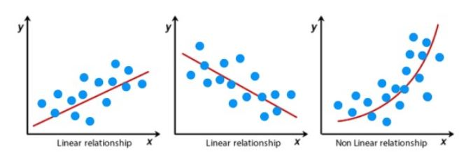
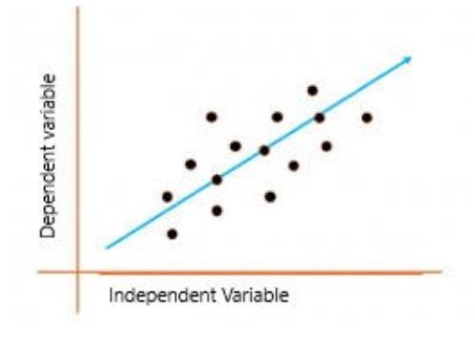
Various type of regression?
Linear Regression:
It assumes a linear relationship between the independent variable and the dependent variable.
Aims to find the best-fitting line that describes the relationship.
The line is determined by minimizing the sum of the squared differences between the predicted values and the actual values.
Fig: Linear and non linear regression

Slide 10
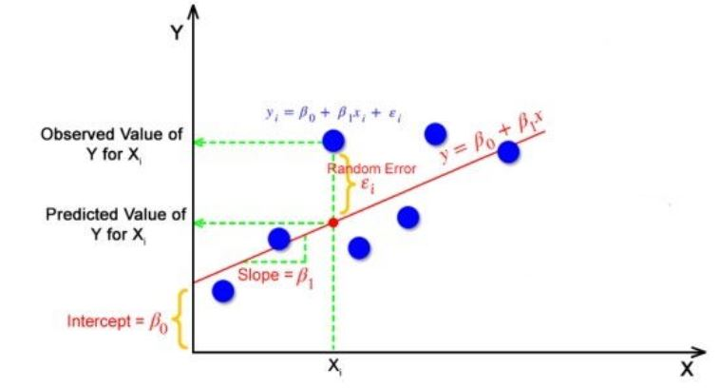
Simple linear regression?
If there is a single input variable X(independent variable), such linear regression is called simple linear regression.
The simple linear regression is represented by the given below Equation
Yi = β0 + β1Xi +ℇ
Where Yi = Dependent variable, β0 = intercept of the line, β1 = Linear regression coefficient (slope of the line) ,
Xi = Independent variable, ℇ = random error, as the best fit line also doesn't include the data points perfectly.

Slide 11
Simple linear regression?
The best fit line is a line that has the least error which means the error between predicted values and actual values should be minimum.
The goal of the linear regression algorithm is to get the best values for B₀ and B₁ to find the best fit line.
The error is measured in terms of mean square error (MSE):
MSE = Σ(yᵢ - ŷᵢ)² / n
yᵢ represents the actual observed value of the dependent variable for the ith data point.
ŷᵢ represents the predicted value of the dependent variable for the ith data point as given by the regression model.
n is the total number of data points in the dataset.

Slide 12
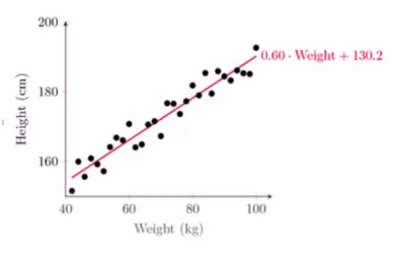
Example: Simple linear regression
A table of weight and height data that could be used to apply a simple linear regression model:
Weight (kg) | Height (cm) |
|-------------|-------------|
| 85 | 175 |
| 92 | 180 |
| 95 | 185 |
| 88 | 178 |
| 100 | 200 |

Slide 13
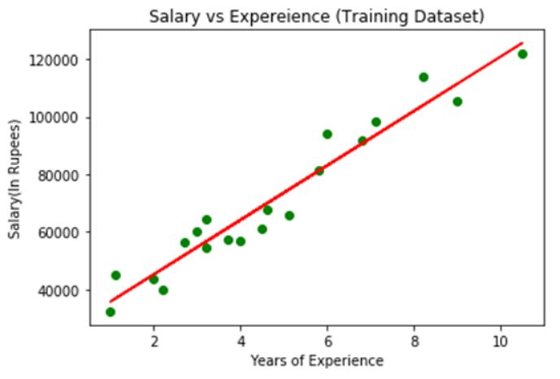
Example: Simple linear regression

Slide 14
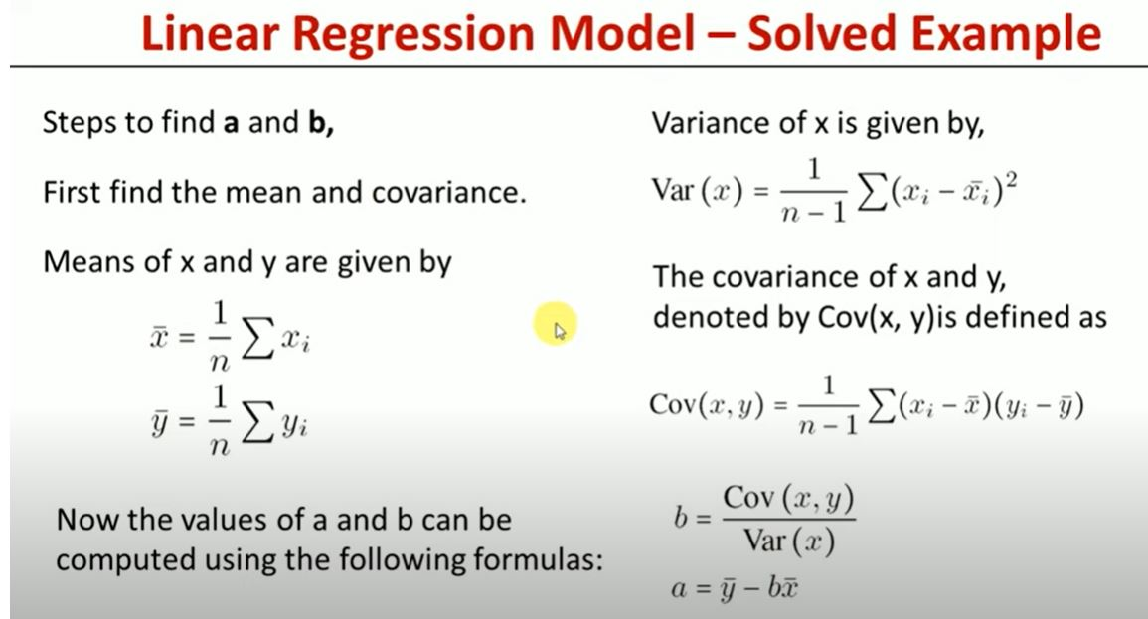
Example: Simple linear regression

Slide 15
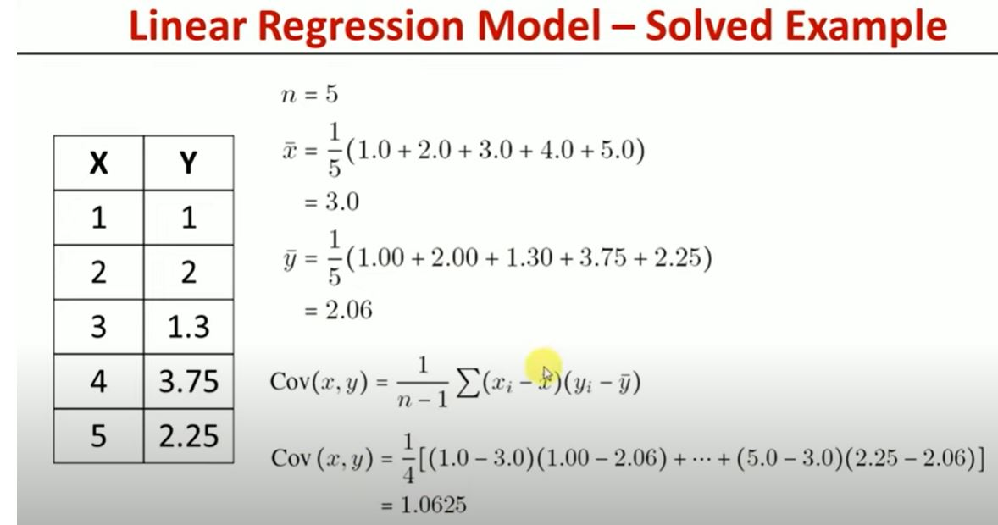
Example: Simple linear regression

Slide 16
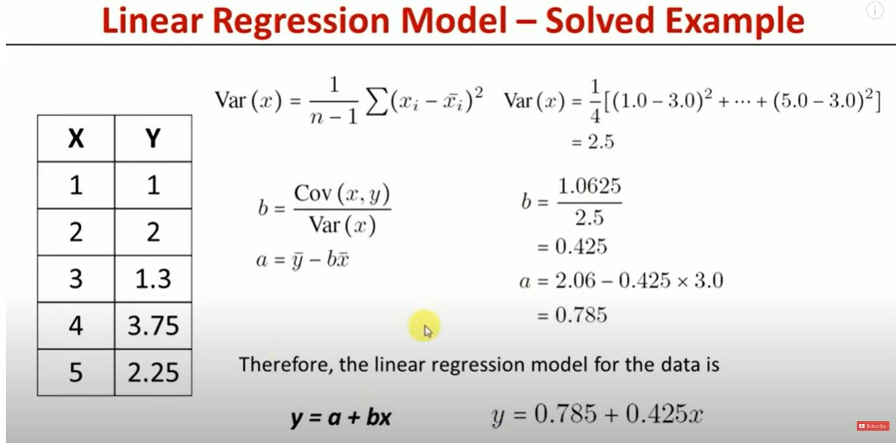
Example: Simple linear regression

Slide 17
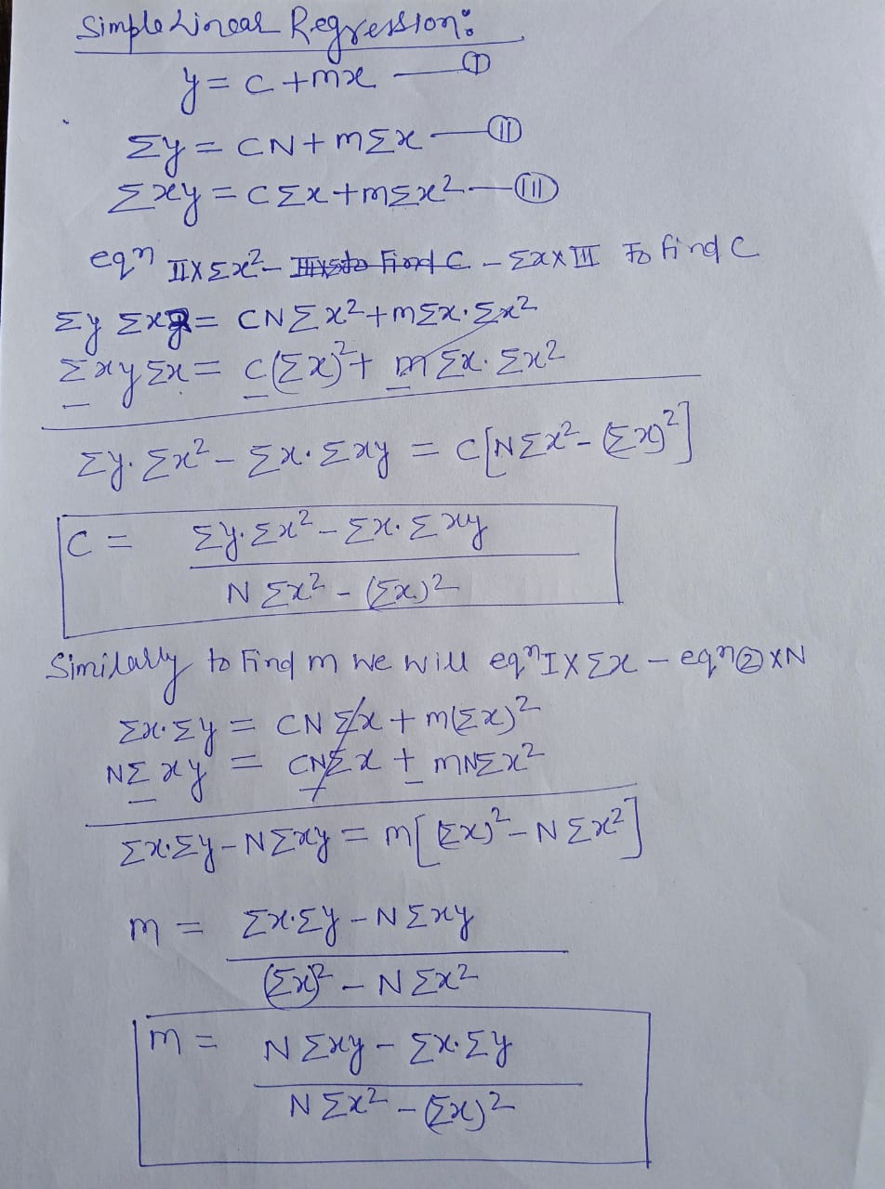
Example: Simple linear regression

Slide 18
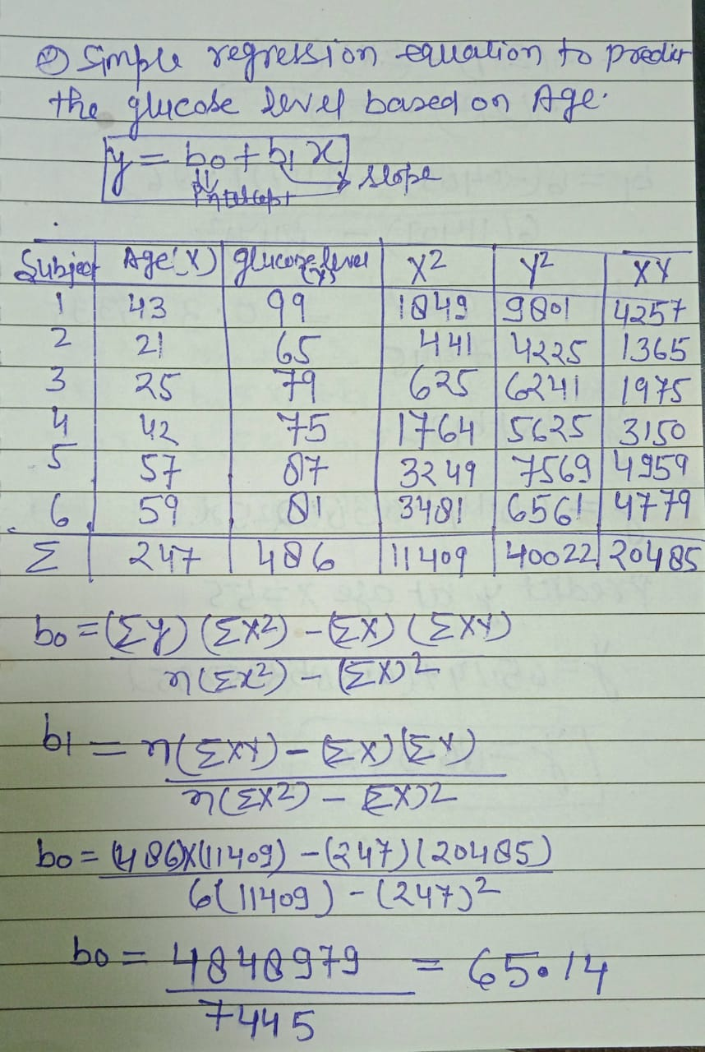
Example: Simple linear regression

Slide 19
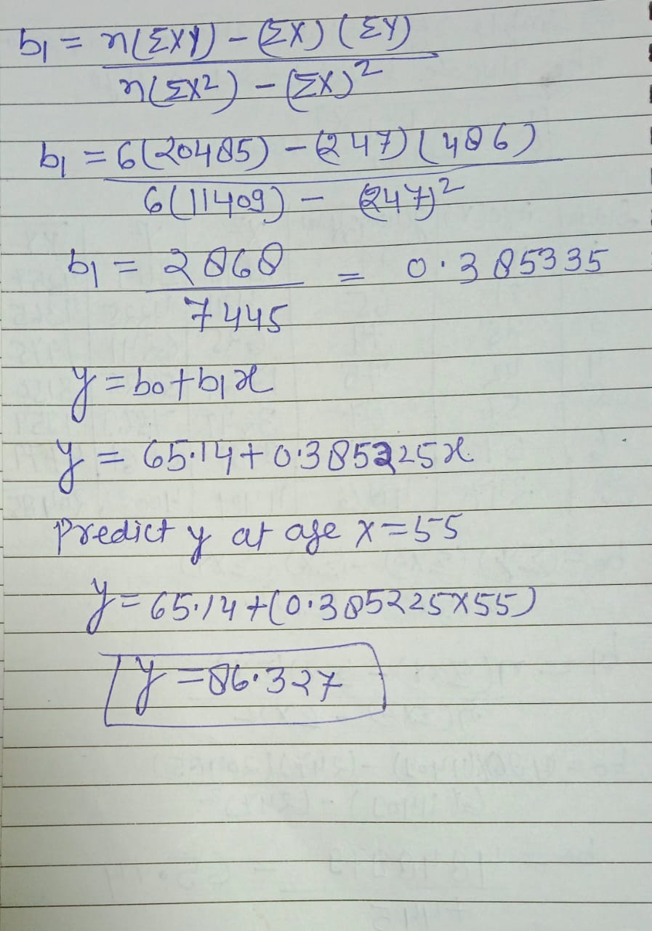
Example: Simple linear regression

Slide 20
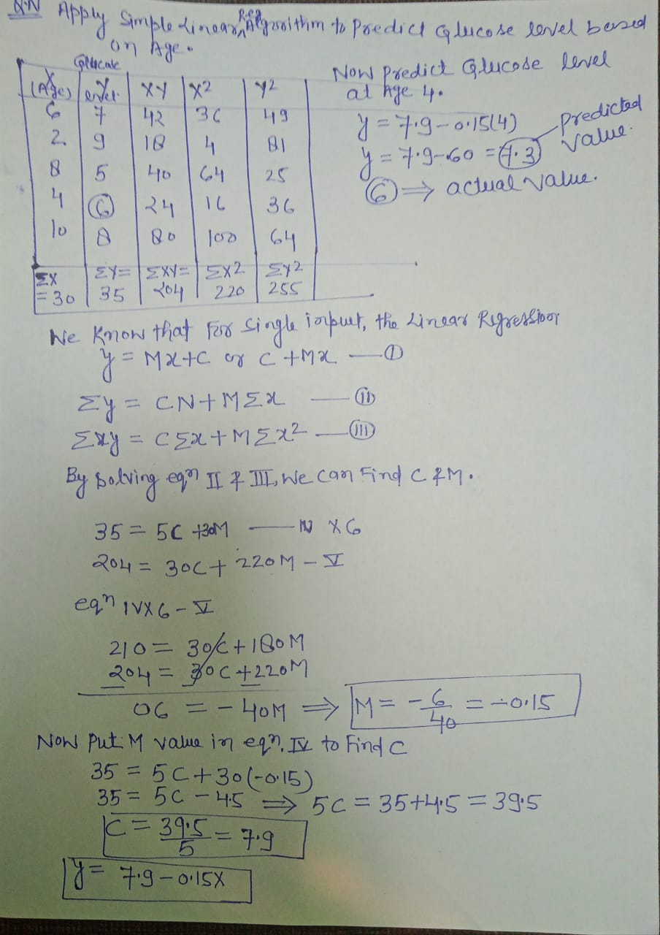
Example: Simple linear regression

Slide 21
Applying Linear Regression Model to Real-life Problems?
In agriculture, linear Regression can be used to predict the amount of rainfall and crop yield.
In banking, it is implemented to predict the probability of loan defaults.
In finance sector, linear Regression is used to predict stock prices and assess associated risks.
In healthcare sector, linear Regression is helpful in modeling healthcare costs, predicting the length of stay in hospitals for patients, etc.
In the domain of sports analytics, Linear Regression can be used to predict the performance of players in upcoming games.
In education to predict student performances in different courses.
Businesses also use Linear Regression to forecast product demands, predict product sales, decide on marketing and advertising strategies, and so on.

Slide 22
Activity-based learning:
Project 1: Loan Default Prediction using Linear Regression
Link: https://www.kaggle.com/datasets/mamtadhaker/lt-vehicle-loan-default-prediction
Project 2: House Price Prediction using Linear Regression
Link: https://www.kaggle.com/datasets/yasserh/housing-prices-dataset
Project 3: Stock Market Prediction using Linear Regression
Link: https://www.kaggle.com/datasets/rohanrao/nifty50-stock-market-data
Project 4: Market Sales Forecasting using Linear Regression
Link: https://www.kaggle.com/datasets/yasserh/walmart-dataset
Project 5: Advertising using Linear Regression
Link: https://www.kaggle.com/datasets/ashydv/advertising-dataset

Slide 23
Polynomial Regression:
Polynomial Regression is a regression algorithm that models the relationship between a dependent(y) and independent variable(x) as nth degree polynomial. The Polynomial Regression equation is given below:
It is also called the special case of Multiple Linear Regression in ML. Because we add some polynomial terms to the Multiple Linear regression equation to convert it into Polynomial Regression.
It is a linear model with some modification in order to increase the accuracy.
The dataset used in Polynomial regression for training is of non-linear nature.
It makes use of a linear regression model to fit the complicated and non-linear functions and datasets.
Hence, "In Polynomial regression, the original features are converted into Polynomial features of required degree (2,3,..,n) and then modeled using a linear model."
y= b₀+b₁x₁+ b₂x₁²+ b₂x₁³+...... b_{n}x₁^{n}

Slide 24
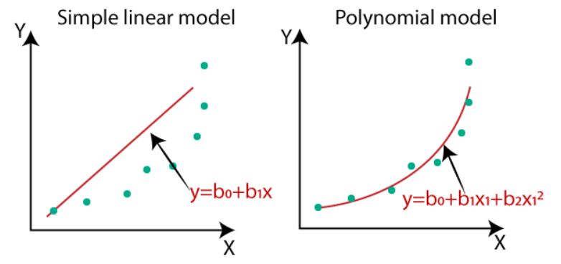
Need for Polynomial Regression:
If we apply a linear model on a linear dataset, then it provides us a good result as we have seen in Simple Linear Regression, but if we apply the same model without any modification on a non-linear dataset, then it will produce a drastic output. Due to which loss function will increase, the error rate will be high, and accuracy will be decreased.
So for such cases, where data points are arranged in a non-linear fashion, we need the Polynomial Regression model. We can understand it in a better way using the below comparison diagram of the linear dataset and non-linear dataset.
Fig: Simple linear and polynomial model [1]

Slide 25
Need for Polynomial Regression:
In the below Fig 1, we have taken a dataset which is arranged non-linearly. So if we try to cover it with a linear model, then we can clearly see that it hardly covers any data point. On the other hand, a curve is suitable to cover most of the data points, which is of the Polynomial model.
Hence, if the datasets are arranged in a non-linear fashion, then we should use the Polynomial Regression model instead of Simple Linear Regression.
Fig: Simple linear and polynomial model [1]
Fig: Simple linear and polynomial model [1]

Slide 26
Equation of the Polynomial Regression Model:
Simple Linear Regression equation: y = b0+b1x .........(a)
Multiple Linear Regression equation: y= b0+b1x+ b2x2+ b3x3+....+ bnxn .........(b)
Polynomial Regression equation: y= b0+b1x + b2x2+ b3x3+....+ bnxn ..........(c)
Suppose there is a dataset which consists of datapoints which are present in a non-linear fashion, so for such case, linear regression will not best fit to those datapoints. To cover such datapoints, we need Polynomial regression.

Slide 27
Role of polynomial degree in polynomial regression :
The main role of the polynomial degree is to control how well the model fits the training data and how well it generalizes to new, unseen data. Here's a breakdown of its role:
Model Flexibility: The degree of the polynomial defines how many bends or curves the regression line can take to fit the data. Higher degrees allow the model to capture more complex and non-linear patterns in the data. Lower degrees result in simpler, more linear models.
Overfitting vs. Underfitting:
Underfitting: When the degree is too low (e.g., linear regression for a highly non-linear relationship), the model may underfit the data. It won't capture the underlying patterns, resulting in poor predictive performance on both the training and test data.
Overfitting: When the degree is too high (e.g., using a very high-degree polynomial), the model may overfit the training data. It fits the noise in the data rather than the actual patterns, leading to poor generalization on new data.

Slide 28
Role of polynomial degree in polynomial regression :
The main role of the polynomial degree is to control how well the model fits the training data and how well it generalizes to new, unseen data. Here's a breakdown of its role:
Bias-Variance Trade-off: The choice of polynomial degree is a part of the bias-variance trade-off. Lower degrees have high bias (they make strong assumptions about linearity) but low variance (they are less sensitive to small fluctuations in the data). Higher degrees have low bias (they can fit complex patterns) but high variance (they are sensitive to noise).
Cross-Validation: To find the optimal polynomial degree, cross-validation techniques like k-fold cross-validation can be used. This helps in selecting a degree that strikes a balance between bias and variance, leading to good generalization.

Slide 29
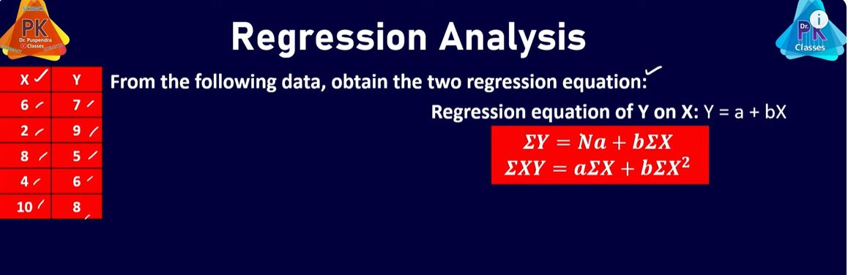
Simple linear regression :

Slide 30
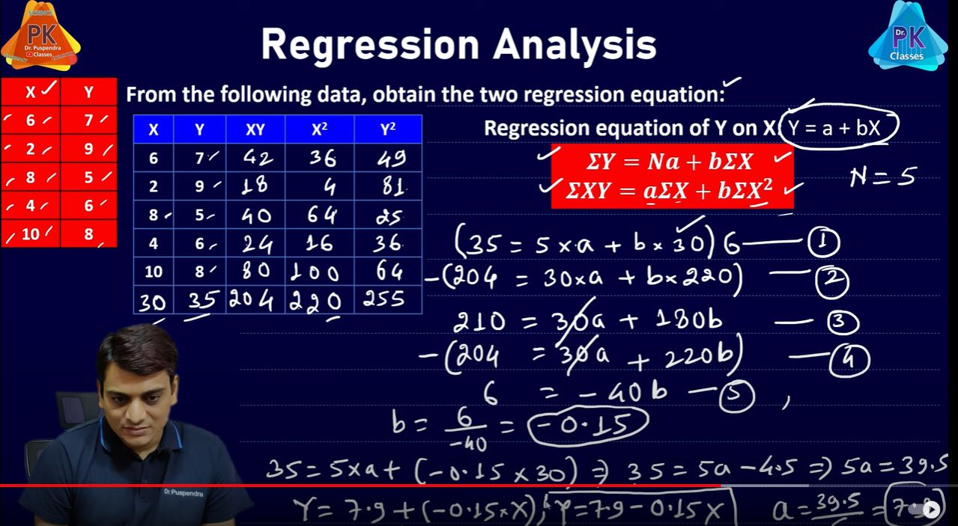
Simple linear regression :

Slide 31
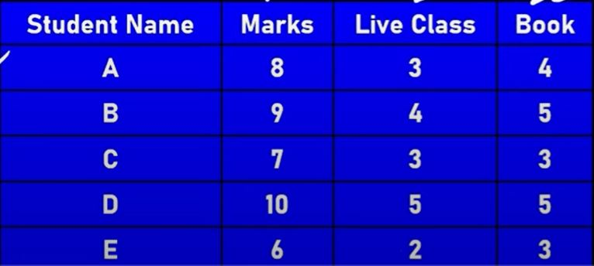
Multiple regression :

Slide 32
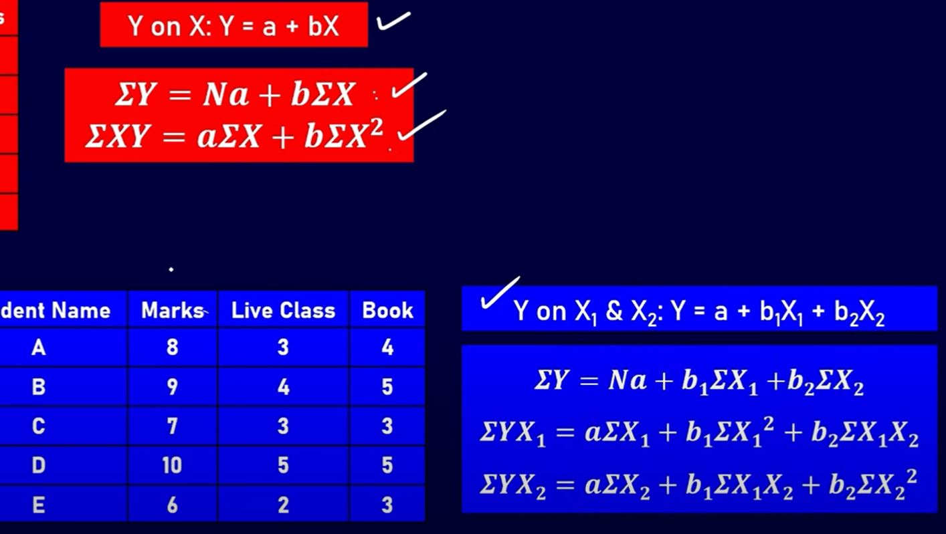
Multiple regression :

Slide 33
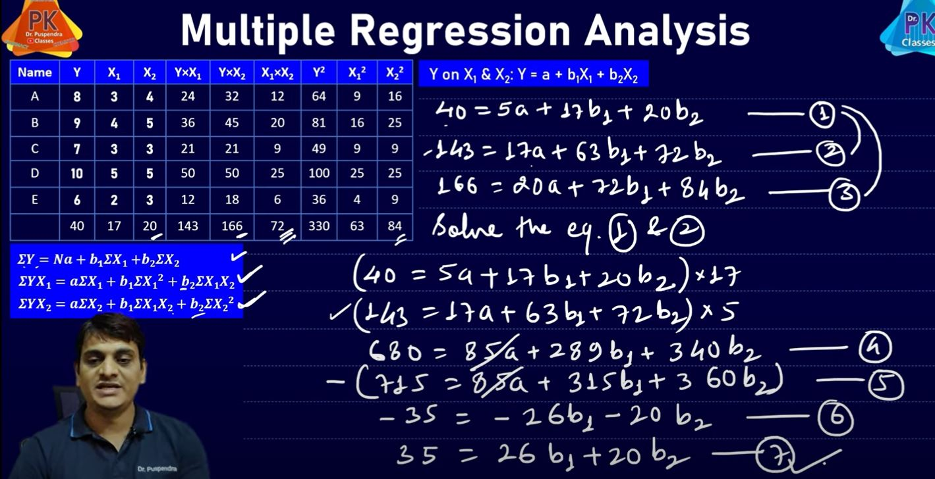
Multiple regression :

Slide 34
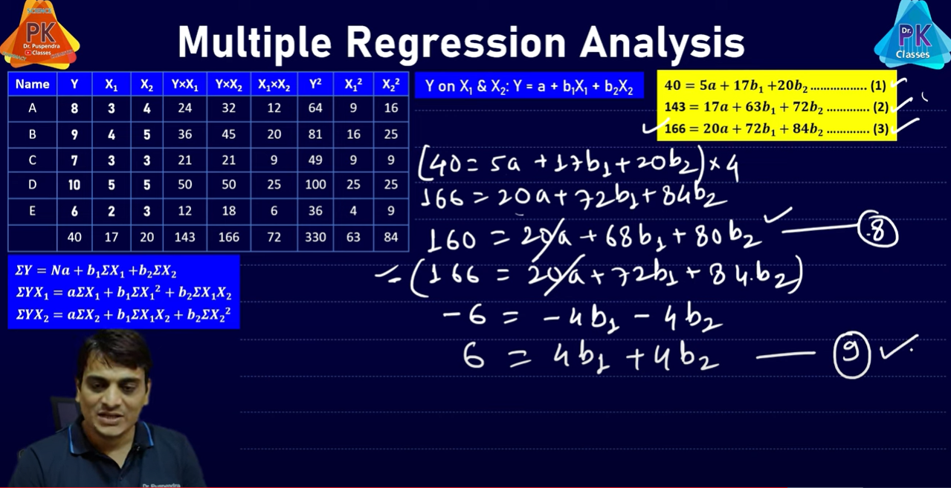
Multiple regression :

Slide 35
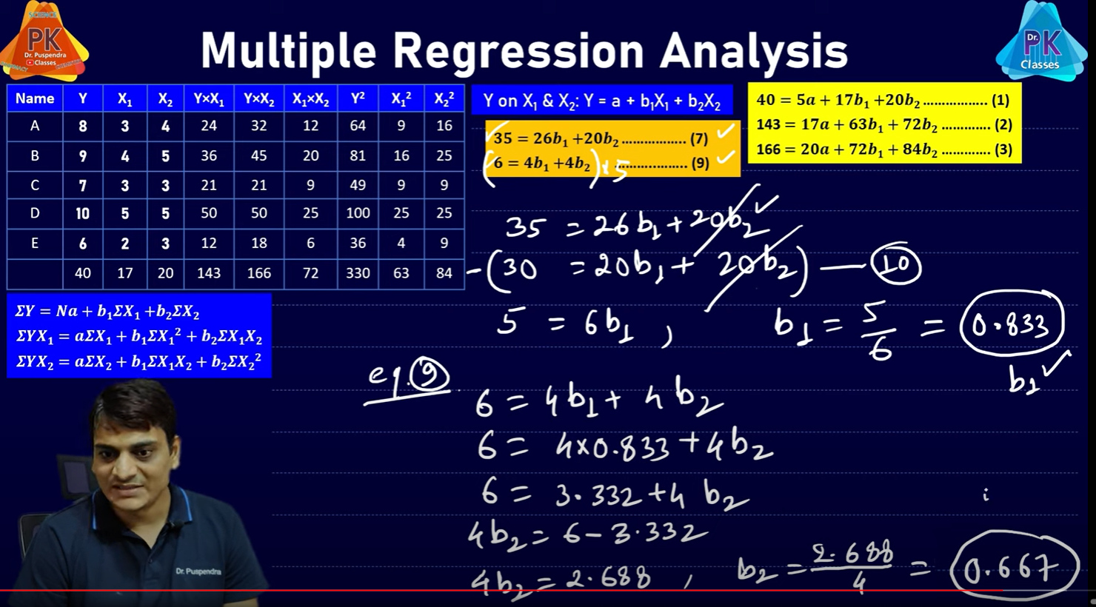
Multiple regression :

Slide 36
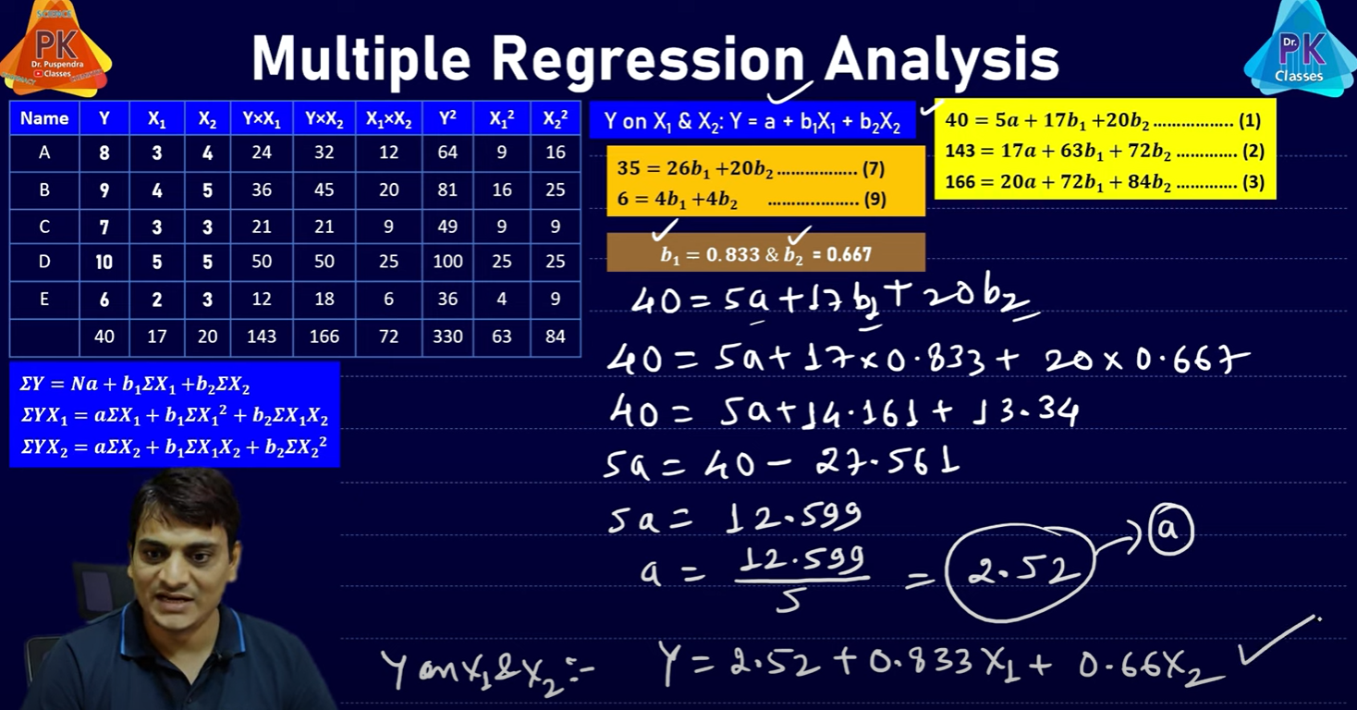
Multiple regression :

Slide 37
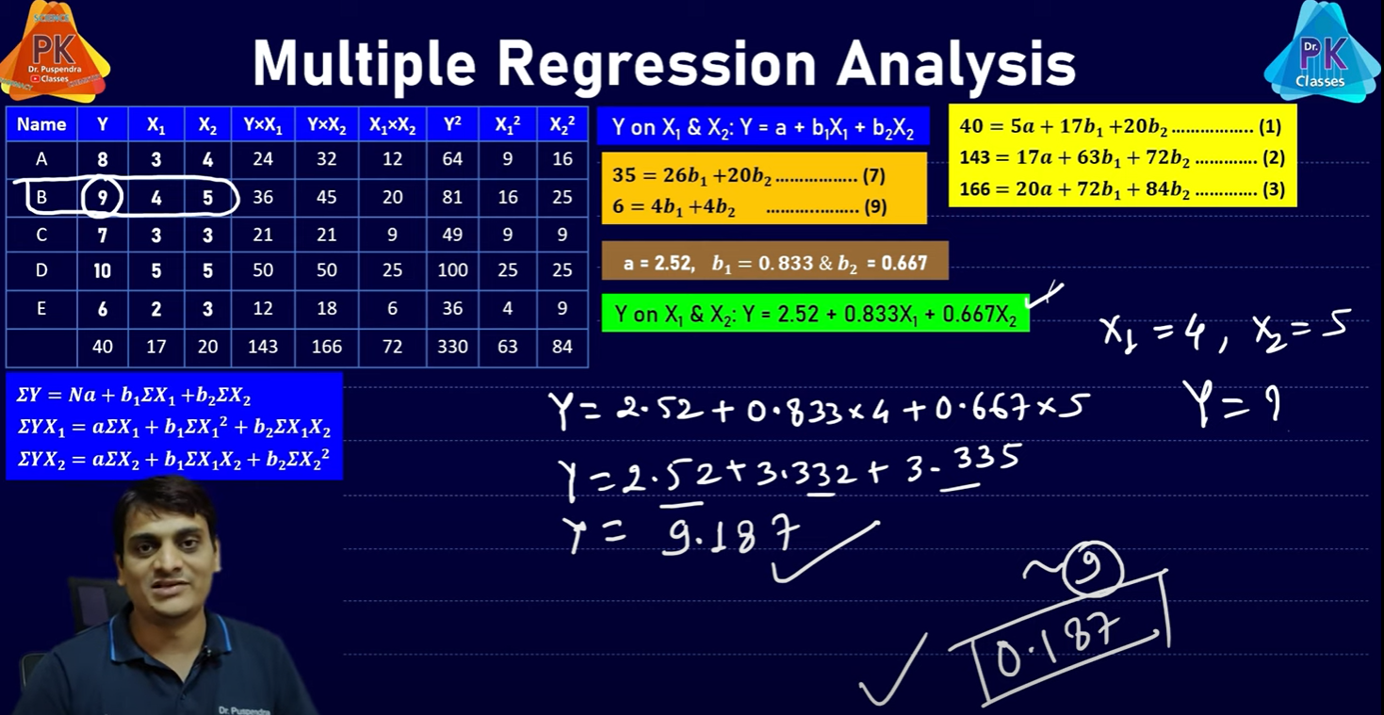
Multiple regression :

Slide 38
Logistic Regression:
Logistic Regression is one of the most widely used Artificial Intelligence algorithms in real-life Machine Learning problems.
Logistic regression is a statistical method used to model the relationship between a binary dependent variable and one or more independent variables.
The goal of logistic regression is to predict the probability of an event occurring based on a set of predictor variables.
In logistic regression, the dependent variable is binary, meaning it can only take on two values, typically labeled as 0 or 1. The independent variables can be either continuous or categorical.
The logistic regression model is based on the logistic function, which is a type of S-shaped curve that maps any continuous input to a probability value between 0 and 1.
The logistic function allows us to model the relationship between the independent variables and the probability of the dependent variable taking on the value of 1.
The logistic regression model estimates the coefficients of the independent variables that are most predictive of the dependent variable. These coefficients are used to create a linear equation that is then transformed by the logistic function to produce a probability value for the dependent variable taking on the value of 1.

Slide 39
Logistic Regression:
The equation for logistic regression is:
p = 1 / (1 + e^(-x))
where p is the probability of the dependent variable in the interval 0,1. x is a linear combination of the independent variables and their coefficients.
The equation can be expanded as follows:
z = b0 + b1<em>x1 + b2</em>x2 + ... + bn*xn
Where b0 is the intercept term, b1, b2,……, bn are the coefficients of the independent variables x1, x2, ... , xn respectively.
The name “logistic regression” comes from the function used in the model, which is called the logistic function or sigmoid function.
The logistic function is a mathematical function that takes any input value and returns an output value between 0 and 1.

Slide 40
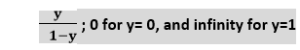
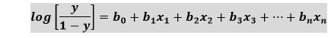
Logistic Regression Equation:
The Logistic regression equation can be obtained from the Linear Regression equation. The mathematical steps to get Logistic Regression equations are given below:
We know the equation of the straight line can be written as:
In Logistic Regression y can be between 0 and 1 only, so for this let's divide the above equation by (1-y):
But we need range between -[infinity] to +[infinity], then take logarithm of the equation it will become:

Slide 41
Logistic Function (Sigmoid Function):
The sigmoid function is a mathematical function used to map the predicted values to probabilities.
It maps any real value into another value within a range of 0 and 1.
The value of the logistic regression must be between 0 and 1, which cannot go beyond this limit, so it forms a curve like the "S" form. The S-form curve is called the Sigmoid function or the logistic function.
In logistic regression, we use the concept of the threshold value, which defines the probability of either 0 or 1. Such as values above the threshold value tends to 1, and a value below the threshold values tends to 0.
Assumptions for Logistic Regression:
The dependent variable must be categorical in nature.
The independent variable should not have multi-collinearity.

Slide 42
Type of Logistic Regression:
On the basis of the categories, Logistic Regression can be classified into three types:
Binomial: In binomial Logistic regression, there can be only two possible types of the dependent variables, such as 0 or 1, Pass or Fail, etc.
Multinomial: In multinomial Logistic regression, there can be 3 or more possible unordered types of the dependent variable, such as "cat", "dogs", or "sheep"
Ordinal: In ordinal Logistic regression, there can be 3 or more possible ordered types of dependent variables, such as "low", "Medium", or "High".

Slide 43
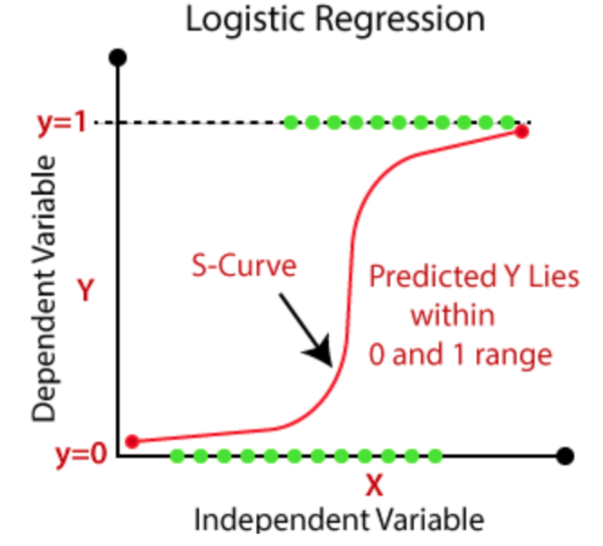
Logistic Regression:
Fig: Logistic Regression [2]

Slide 44
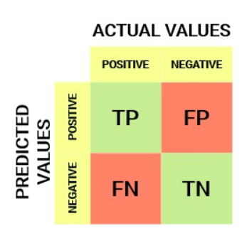
Confusion Matrix:
Confusion matrix: Confusion matrix is a performance measurement for machine learning Classification problem where output can be two or more classes. Confusion matrix is a square matrix/table with 4 different combinations of predicted and actual values.
The confusion matrix consists of four parameters: True Positives (TP), True Negatives (TN), False Positives (FP), and False Negatives (FN). Confusion matrix is highly useful for calculating Recall, Precision, Specificity, Accuracy, and most importantly AUC-ROC curves.
True Positive (TP): Actual Positive and Predicted as Positive
True Negative (TN): Actual Negative and Predicted as Negative
False Positive (FP, Type I Error): Actual Negative but predicted as Positive
False Negative(FN, Type II Error): Actual Positive but predicted as Negative
TP +TN =Correct prediction
FP+FN = Wrong prediction Fig: Confusion Matrix [3]

Slide 45
Evaluation Metrics for Classification:
Accuracy: Accuracy measures the percentage of correctly classified instances out of all instances. While accuracy is a commonly used metric, it can be misleading if the data is imbalanced, meaning one class is much more frequent than the other.
Formula: (TP + TN) / (TP + TN + FP + FN)
Precision: Precision measures the proportion of true positive predictions out of all positive predictions. It focuses on the model’s ability to correctly identify positive cases.
Formula: TP / (TP + FP)
Recall (Sensitivity, True Positive Rate, TPR): It measures the proportion of true positive predictions out of all actual positive cases. It focuses on the model’s ability to identify all positive cases, even if it results in some false positives.
Formula: TP / (TP + FN)
F1 Score: The harmonic mean of precision and recall, providing a balance between precision and recall.
Formula: 2 * (Precision * Recall) / (Precision + Recall)

Slide 46
Evaluation Metrics for Logistic Regression:
Specificity (True Negative Rate, TNR): The proportion of true negative predictions out of all actual negative instances in the data.
Formula: TN / (TN + FP)
False Positive Rate (FPR): The proportion of false positive predictions out of all actual negative instances in the data.
Formula: FP / (FP + TN)
AUC-ROC: The AUC-ROC measures the model’s ability to distinguish between the positive and negative classes. It is a measure of the tradeoff between the true positive rate and the false positive rate.
Confusion matrix: A confusion matrix is a table that summarizes the performance of a classification model. It shows the number of true positives, true negatives, false positives, and false negatives.

Slide 47
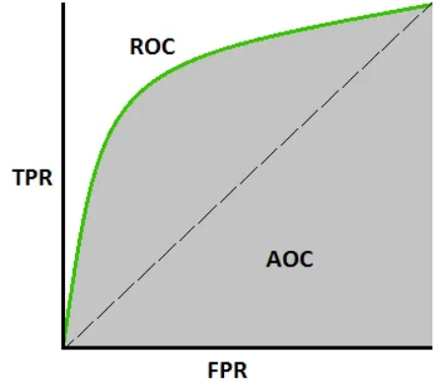
Area under the Curve-Receiver operating characteristics (AUC-ROC) Curve :
AUC - ROC curve is a performance measurement for the classification problems at various threshold settings.
ROC is a probability curve and AUC represents the degree or measure of separability. It tells how much the model is capable of distinguishing between classes.
Higher the AUC, the better the model is at predicting 0 classes as 0 and 1 classes as 1. By analogy, the Higher the AUC, the better the model is at distinguishing between patients with the disease and no disease.
The ROC curve is plotted with TPR against the FPR where TPR is on the y-axis and FPR is on the x-axis.
Fig: AUC-ROC Curve [4, towardsdatascience.com]

Slide 48
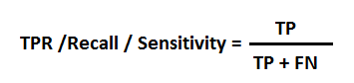
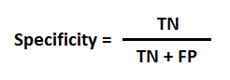
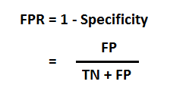
Defining terms used in AUC and ROC Curve :
TPR (True Positive Rate) / Recall /Sensitivity:
Specificity (True Negative Rate, TNR):
FPR:

Slide 49
How to speculate about the performance of the model?
A Receiver Operating Characteristic (ROC) curve is a graphical plot that illustrates the performance of a binary classifier system as the discrimination threshold is varied.
An excellent model has AUC near to the 1 which means it has a good measure of separability.
And when AUC is 0.5, it means the model has no class separation capacity whatsoever.
A poor model has an AUC near 0 which means it has the worst measure of separability. In fact, it means it is reciprocating the result. It is predicting 0s as 1s and 1s as 0s.
As we know, ROC is a curve of probability. So let's plot the distributions of those probabilities:
Note: Red distribution curve is of the positive class (patients with disease) and the green distribution curve is of the negative class(patients with no disease).

Slide 50
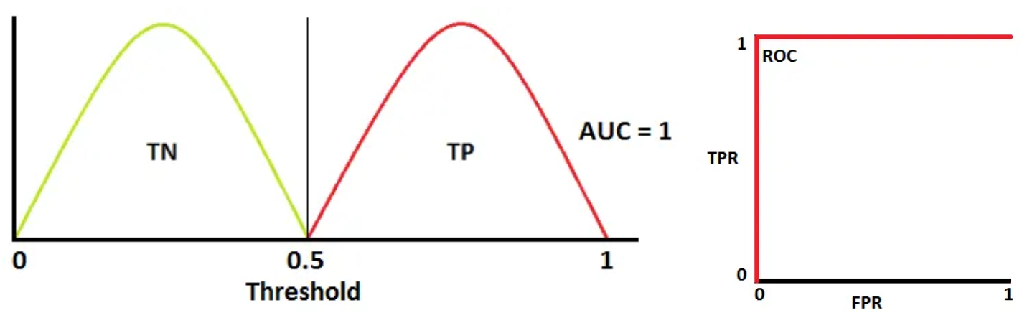
How to speculate about the performance of the model?
This is an ideal situation. When two curves don’t overlap at all means model has an ideal measure of separability.
It is perfectly able to distinguish between positive class and negative class.

Slide 51
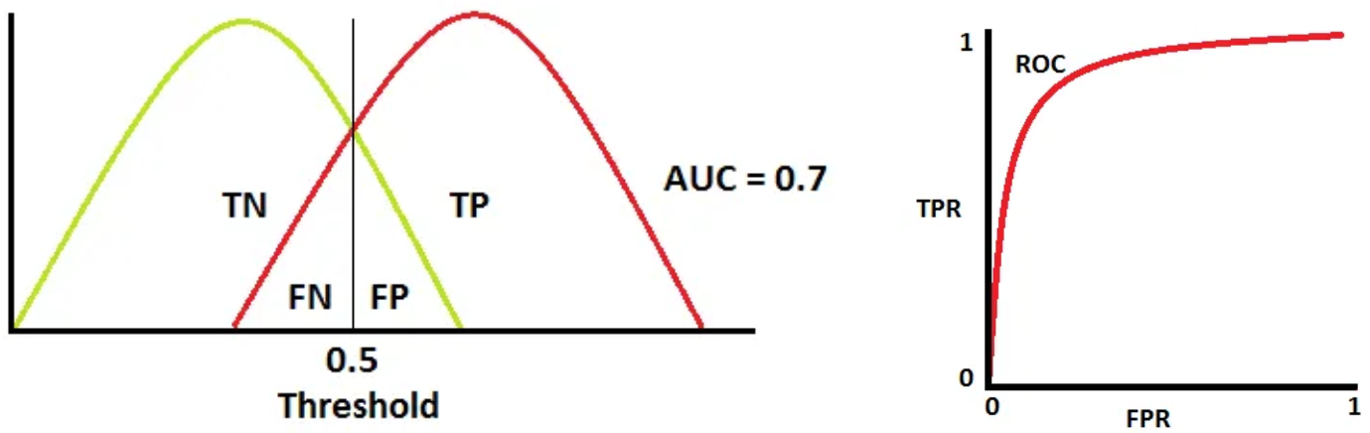
How to speculate about the performance of the model?
When two distributions overlap, we introduce type 1 and type 2 errors.
Depending upon the threshold, we can minimize or maximize them.
When AUC is 0.7, it means there is a 70% chance that the model will be able to distinguish between positive class and negative class.

Slide 52
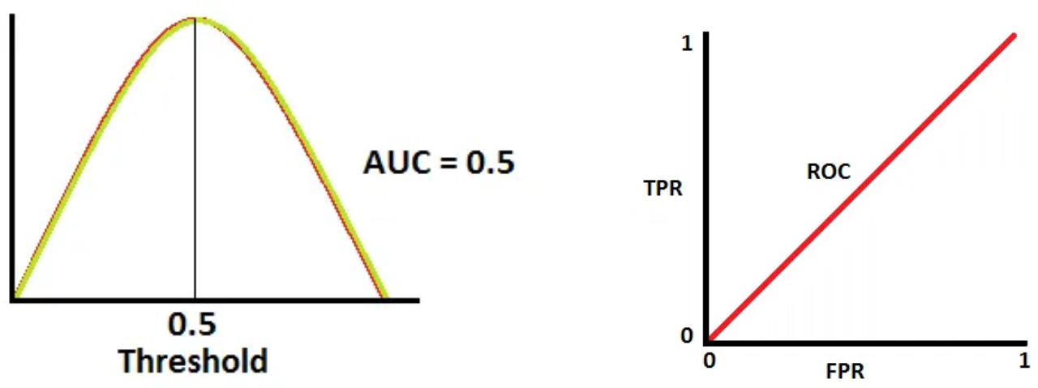
How to speculate about the performance of the model?
This is the worst situation. When AUC is approximately 0.5, the model has no discrimination capacity to distinguish between positive class and negative class.

Slide 53
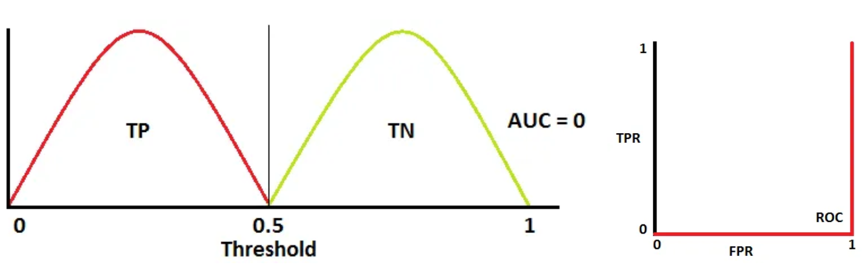
How to speculate about the performance of the model?
When AUC is approximately 0, the model is actually reciprocating the classes. It means the model is predicting a negative class as a positive class and vice versa.

Slide 54
The relation between Sensitivity, Specificity, FPR, and Threshold:
Sensitivity and Specificity are inversely proportional to each other. So when we increase Sensitivity, Specificity decreases, and vice versa.
Sensitivity⬆️, Specificity⬇️
Sensitivity⬇️, Specificity⬆️
When we decrease the threshold, we get more positive values thus it increases the sensitivity and decreasing the specificity.
Similarly, when we increase the threshold, we get more negative values thus we get higher specificity and lower sensitivity.
As we know FPR is 1 - specificity. So when we increase TPR, FPR also increases and vice versa.
TPR⬆️, FPR⬆️
and TPR⬇️, FPR⬇️
Link: https://towardsdatascience.com/understanding-auc-roc-curve-68b2303cc9c5

Slide 55
Key benefits of Logistic regression:
1 Interpretable results:
Logistic regression models provide coefficients for each feature, indicating the direction and magnitude of the impact on the outcome variable. This makes it easy to interpret the results and understand the factors that are driving the predictions.
2 Fast and efficient:
Logistic regression is a relatively simple algorithm and can be trained quickly on large datasets. It is also computationally efficient and can be used to make predictions in real-time.
3 Robust to noise:
Logistic regression is less susceptible to overfitting than other machine learning algorithms. This is because it has a simpler hypothesis space and fewer parameters to estimate.
4 Can handle both binary and continuous variables:
Logistic regression can handle both categorical (binary) and continuous variables, making it a versatile tool for a wide range of applications.
4.5 Works well with small datasets:
Logistic regression can be used to model small datasets and still produce accurate predictions.
4.6 Can be regularized:
Logistic regression can be regularized to prevent overfitting and improve generalization performance.

Slide 56
Assumptions of the Logistic Regression:
1. Linearity of the logit: Logistic regression assumes that the logit of the outcome variable is a linear combination of the predictor variables. This means that the relationship between the predictors and the outcome is log-linear.
2. Independence of errors: The errors in logistic regression should be independent of each other, which means that there should be no correlation between the errors in the model. This assumption is important because correlated errors can bias the estimates of the model parameters.
3. Absence of multicollinearity: Logistic regression assumes that there is no high correlation between the predictor variables. This is because multicollinearity can lead to unstable estimates of the model parameters.
4. No outliers: Outliers in the data can have a disproportionate impact on the estimates of the model parameters. Therefore, logistic regression assumes that there are no outliers in the data.
5. Large sample size: Logistic regression assumes that the sample size is large enough to estimate the model parameters accurately. As a rule of thumb, the sample size should be at least ten times the number of predictor variables.
6. Binary outcome: Logistic regression is designed for binary outcomes, where the response variable takes on one of two possible values. If the outcome variable is continuous, then linear regression is a more appropriate model.
7. No perfect separation: Logistic regression assumes that there is no perfect separation in the data, which means that there is no combination of predictor variables that can perfectly predict the outcome variable.

Slide 57
Challenges and limitations of logistic Regression:
Linearity Assumption: Logistic regression assumes that the relationship between the independent variables and the log odds of the dependent variable is linear. If this assumption is not met, the model may produce biased or inaccurate results.
Overfitting: Logistic regression models can overfit the data, meaning they fit the noise rather than the underlying signal. This can lead to poor performance on new, unseen data.
Multicollinearity: If the independent variables in the model are highly correlated with each other, this can lead to unstable estimates and difficulty interpreting the results.
Outliers: Logistic regression models can be sensitive to outliers, which can distort the estimates and lead to inaccurate predictions.
Imbalanced Classes: When the classes in the dependent variable are imbalanced, meaning one class is much more prevalent than the other, logistic regression can produce biased results. This can be mitigated by using techniques such as undersampling or oversampling.

Slide 58
Challenges and limitations of logistic Regression:
Model Interpretation: Logistic regression can be challenging to interpret, particularly when there are multiple independent variables in the model. It can be difficult to determine which variables are most important in predicting the outcome.
Limited Predictive Power: Logistic regression is a linear model and may not capture complex nonlinear relationships between the independent variables and the dependent variable. In such cases, other machine learning algorithms such as decision trees or neural networks may be more appropriate.
Assumptions of Independence: Logistic regression assumes that the observations are independent of each other, and violations of this assumption can lead to inaccurate estimates and standard errors.
Missing Data: Logistic regression assumes that the data are complete, and missing data can be a challenge. Missing data can lead to biased estimates, and techniques such as imputation may be needed to handle missing data.

Slide 59
Applications of the Logistic Regression:
Binary Classification: Logistic regression is most commonly used for binary classification problems, where the goal is to predict whether an observation belongs to one of two classes. For example, predicting whether a customer will churn or not, or whether a patient has a particular disease or not.
Customer Segmentation: Logistic regression can be used to segment customers based on their characteristics or behavior. This helps businesses to tailor their marketing strategies to different groups of customers.
Credit Scoring: Logistic regression is often used in credit scoring models to predict the probability of default on a loan or credit card. This helps lenders to make better decisions about which applicants to approve and at what interest rates.
Fraud Detection: Logistic regression can be used to detect fraudulent transactions or activities. By analyzing patterns of behavior, logistic regression models can flag suspicious transactions and alert fraud investigators.
Market Analysis: Logistic regression can be used to analyze consumer behavior and predict market trends. By identifying factors that influence buying decisions, businesses can adjust their marketing strategies to better target their customers.

Slide 60
Applications of the Logistic Regression:
Medical Diagnosis: Logistic regression can be used to diagnose diseases or medical conditions based on patient symptoms or test results. This helps doctors to make better treatment decisions and improve patient outcomes.
Political Science: Logistic regression can be used to model voting patterns or predict election outcomes. By analyzing polling data and demographic trends, logistic regression models can provide insights into political behavior.
Sports Analytics: Logistic regression can be used to predict the outcome of sporting events based on team performance and other factors. This helps sports teams to make better decisions about player recruitment and game strategies.
Link: https://sparkbyexamples.com/machine-learning/logistic-regression-explained-with-examples/

Slide 61
Support Vector Machine:
SVM is a supervised machine learning algorithm which is used for Classification as well as Regression problems.
However, primarily, it is used for Classification problems in Machine Learning.
SVM aims is to find best line/decision boundary/hyperplane that can segregate n-dimensional space into distinct classes. so that we can easily put the new data point in the correct category in the future.
Hyperplane: It's a decision boundary that maximizes the margin between classes.
Margin: The margin is the distance between the hyperplane and the nearest data points from each class. SVM aims to maximize this margin.
Support Vectors: Support vectors are data points that are closer to the hyperplane and influence the position and orientation of the hyperplane are termed as Support Vector. Since these vectors support the hyperplane, hence called a Support vector.
Kernel Trick: SVM can handle non-linear data by mapping the low-dimensional space into a higher-dimensional space using kernel functions.
C Parameter: It controls the trade-off between maximizing the margin and minimizing the classification error. A smaller C emphasizes a wider margin, while a larger C allows for more errors.

Slide 62
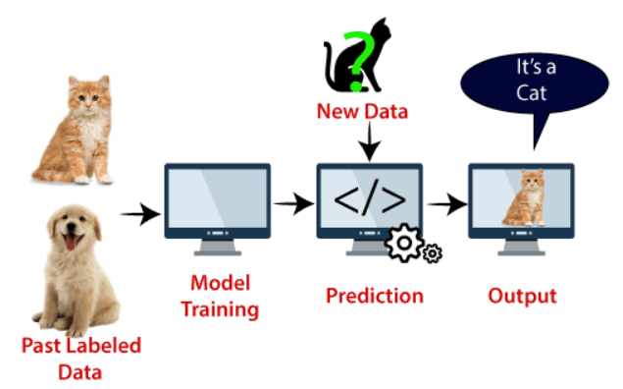
Support Vector Machine:
SVM algorithm can be used for Face detection, image classification, text categorization, etc.
The dimensions of the hyperplane depend on the features present in the dataset, which means if there are 2 features (as shown in image), then hyperplane will be a straight line. And if there are 3 features, then hyperplane will be a 2-dimension plane.
Fig: animal classification using SVM

Slide 63
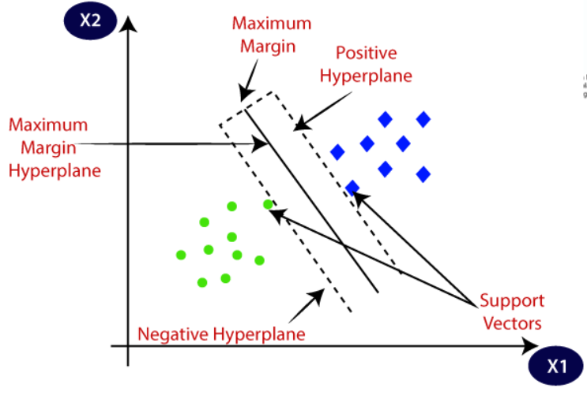
Support Vector Machine:
We always create a hyperplane that has a maximum margin, which means the maximum distance between the data points.
Fig: Hyperplane [5]

Slide 64
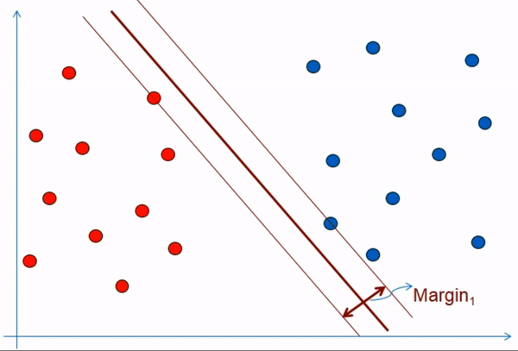
Support Vector Machine:
Fig: Appropriate Hyperplane drawn with maximum margin [6]

Slide 65
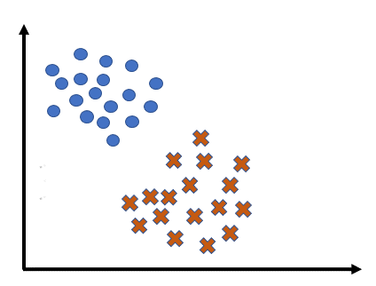
Support Vector Machine:
Fig: Appropriate Hyperplane drawn with maximum margin [7]

Slide 66
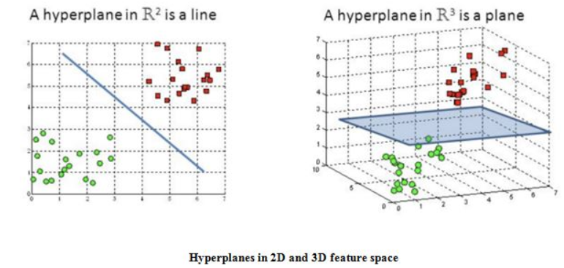
Hyperplane:
Hyperplanes are decision boundaries that help classify the data points. Data points falling on either side of the hyperplane can be attributed to different classes.
Also, the dimension of the hyperplane depends upon the number of features.
If the number of input features is 2, then the hyperplane is just a line.
If the number of input features is 3, then the hyperplane becomes a two-dimensional plane.
It becomes difficult to imagine when the number of features exceeds 3.

Slide 67
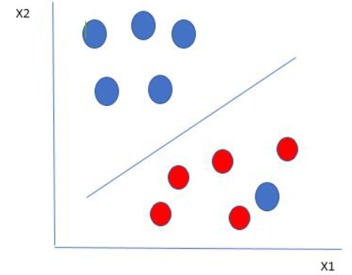
SVM is robust to outliers:
Here we have one blue ball in the boundary of the red ball. So how does SVM classify the data? It’s simple! The blue ball in the boundary of red ones is an outlier of blue balls. The SVM algorithm has the characteristics to ignore the outlier and finds the best hyperplane that maximizes the margin. SVM is robust to outliers.
Fig: Outliers [8]

Slide 68
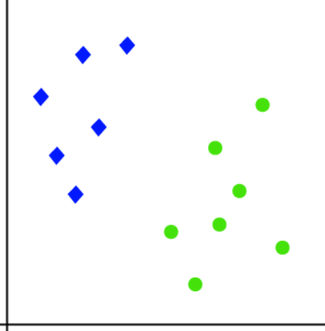
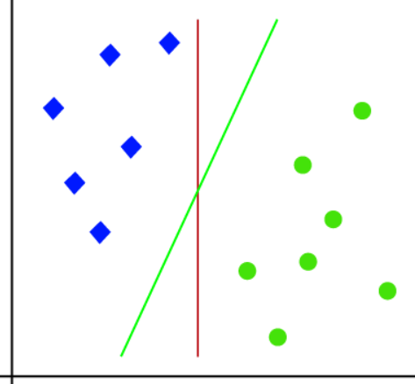
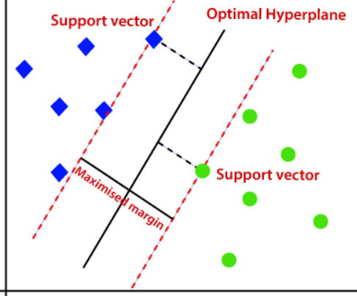
SVM Type:
Linear SVM:
Linear SVMs use a linear decision boundary to separate the data points of different classes.
When the data can be precisely linearly separated, linear SVMs are very suitable. This means that a single straight line (in 2D) or a hyperplane (in higher dimensions) can entirely divide the data points into their respective classes.
Fig: Linear SVM [5]

Slide 69
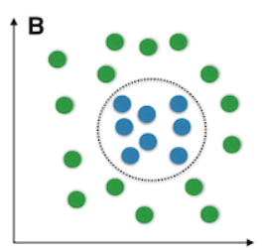
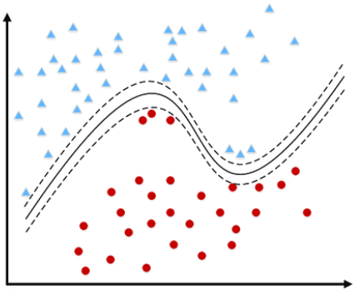
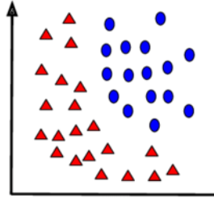
SVM Type:
Non-Linear SVM:
Non-Linear SVM can be used to classify data when it cannot be separated into two classes by a straight line (in the case of 2D).
By using kernel functions, nonlinear SVMs can handle nonlinearly separable data.
The original input data is transformed by these kernel functions into a higher-dimensional feature space, where the data points can be linearly separated.
A linear SVM is used to locate a nonlinear decision boundary in this modified space.
Fig: Non-Linear data points [8]

Slide 70
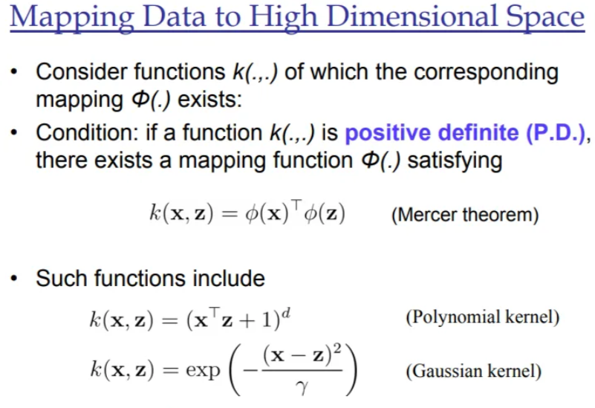
Kernel Trick :
Kernel Trick is used to classify non-linear to linear using some Mathematical Concepts provided by Mercer’s theorem.
It converts non-linear lower dimension space to a higher dimension space thereby we can get a linear classification.
So, we are projecting the data with some extra features so that it can convert to a higher dimension space.

Slide 71
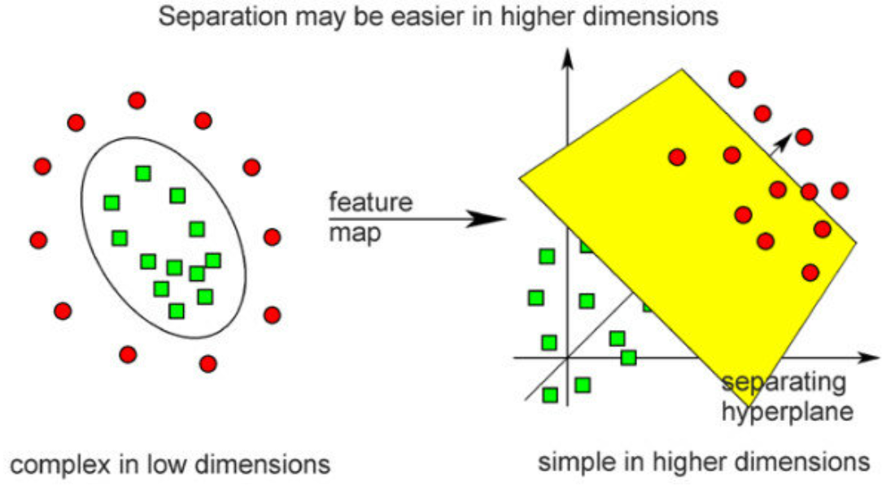
Kernel Trick :
input data is mapped to higher dimension by passing through a kernel and then class blue and red are linearly separated by the hyperplane with maximum margin distance from support vectors.
Fig: Mapping low-dimension to high-dimension space using kernal [9]

Slide 72


Kernel Trick :
we want our model to distinguish mangoes and guavas on the x-axis, as seen in the diagram below. Our model is unable to separate them using a specific “point” on the x-axis that can differentiate both of these classes since such a point is not present here.
the kernel will transform the data populated on the x-axis using the mathematical function “f = x ^ 2″. This function will transform the straight line into a parabola where the classification is linear and relatively easier using the hyperplane.
Fig: Mapping low-dimension to high-dimension space using kernal [9]

Slide 73

Kernel Trick :
Fig: Mapping 2-dimension to 3-dimension space using kernal [11]

Slide 74

Kernel Trick :
Fig: Mapping low-dimension to high-dimension space using kernal [11]

Slide 75

SVM Parameter C:
While building the model, we use a hyperparameter called “Cost. It is denoted by “C”.
The influence of C’s value on the margin is depicted in the diagram below. When the value is small, for example, C=1, the margin widens, while when the value is high, the margin narrows down.
Small‘C’Value—->LargeBudget—–>WideMargin——>Allows more misclassification
Large ‘C’ Value —-> Small Budget —–> Narrow Margin ——> Allows less misclassification
Fig: Effect of C value [9]

Slide 76
Listed below are a few SVM Kernels.:
Linear Kernel:
F(x, y) = sum( x.y)
Here, x, y represents the data you’re trying to classify.
The linear kernel is equivalent to the Support Vector Classifier.
Polynomial Kernel:
F(x, y) = (x.y+1)^d
It is better than the Linear Kernel. Here d denotes the degree of the polynomial.
Radial Kernel:
It is highly recommended for classifying non-linear data.
The radius of impact for each point is defined by the gamma value. Where a high gamma value corresponds to a small radius of influence for each data and a low gamma value corresponds to a wide radius of influence for each data.
F(x, y) = exp (-gamma * ||x – y||^2)

Slide 77


Neural Network: Introduction
A neural network is a computational model inspired by the structure and function of the human brain (because mimic the basic functioning of the human brain).
It consists of interconnected nodes, called neurons, organized into layers.
Neural Networks are complex systems with artificial neurons. Artificial neurons/perceptron consist of: Input, Weight, Bias, Activation Function, and Output.
Fig: Neural Network [12, javatpoint]

Slide 78
Neural Network: Architecture
Neural network architecture refers to the specific layout and structure of a neural network, including the number of layers, the number of neurons or units in each layer, and the connections between them.
The architecture of a neural network greatly affects its performance and suitability for different tasks.
Here are some key components and terms associated with neural network architecture:
Input Layer:
The first layer of a neural network.
Neurons in this layer receive the raw input data and pass it on to the subsequent layers.
The number of neurons in the input layer corresponds to the dimensionality of the input data.
Hidden Layers:
Layers that come after the input layer and before the output layer.
The term "hidden" indicates that these layers do not directly interact with the external environment.
Neural networks can have multiple hidden layers, creating a deep neural network (DNN).

Slide 79
Neural Network: Architecture
Output Layer:
The final layer of a neural network.
Neurons in this layer produce the network's output, which can be a prediction, classification, or any relevant task-specific result.
The number of neurons in the output layer depends on the task; for example, binary classification may have one neuron, while multiclass classification may have multiple neurons.
Neurons/Units/Nodes:
Neurons or units are the basic processing units in a neural network.
Each neuron takes weighted inputs, applies an activation function, and produces an output.
The number of neurons in hidden layers is a hyperparameter chosen during network design.
Weights and Biases:
Weights are parameters that determine the strength of connections between neurons in different layers.
Biases are additional parameters that help shift the output of a neuron.
During training, these values are adjusted through backpropagation to minimize the network's error.
Activation Functions:
Activation functions introduce non-linearity to the network.
Common activation functions include sigmoid, hyperbolic tangent (tanh), rectified linear unit (ReLU), and variants like Leaky ReLU.
Activation functions determine whether a neuron should be activated (produce an output) based on its input.

Slide 80
Neural Network: Architecture
Feedforward Architecture:
In feedforward neural networks, information flows in one direction, from the input layer through the hidden layers to the output layer.
This architecture is suitable for tasks like classification and regression.
Recurrent Connections:
Some neural network architectures, like Recurrent Neural Networks (RNNs), have connections that loop back on themselves, allowing information to be passed from one step to the next in a sequence.
These are crucial for sequence-related tasks.
Dropout:
Dropout is a regularization technique used to prevent overfitting.
During training, it randomly "drops out" or deactivates a fraction of neurons in each layer to encourage robust learning.

Slide 81
Neural Network: Architecture
Batch Normalization:
A technique that normalizes the activations in a neural network layer to stabilize and accelerate training.
It helps to mitigate issues like the vanishing gradient problem.
Skip Connections:
Commonly used in deep neural networks like Residual Neural Networks (ResNets).
Skip connections allow information to flow through the network without passing through every layer, helping mitigate the vanishing gradient problem and facilitating the training of very deep networks.
Attention Mechanisms:
Used in architectures like Transformers.
Attention mechanisms allow the network to focus on specific parts of the input sequence, enabling more efficient and effective processing of sequential data

Slide 82
Learning in Neural Networks:
There are 3 types of learnings in Neural networks, namely
Supervised learning
Unsupervised learning
Reinforcement learning

Slide 83

Learning in Neural Networks: Supervised Learning
As the name suggests, it is a type of learning that is looked after by a supervisor. It is like learning with a teacher.
There are input training pairs that contain a set of input and the desired output. Here the output from the model is compared with the desired output and an error is calculated, this error signal is sent back into the network for adjusting the weights.
This adjustment is done till no more adjustments can be made and the output of the model matches the desired output. In this, there is feedback from the environment to the model.
Fig: Neural network learning by supervised learning [13]

Slide 84

Learning in Neural Networks: Unsupervised Learning
Unlike supervised learning, there is no supervisor or a teacher here. In this type of learning, there is no feedback from the environment, there is no desired output and the model learns on its own.
During the training phase, the inputs are formed into classes that define the similarity of the members. Each class contains similar input patterns. On inputting a new pattern, it can predict to which class that input belongs based on similarity with other patterns. If there is no such class, a new class is formed.
Fig: Neural network learning by unsupervised learning [13]

Slide 85

Learning in Neural Networks: Reinforcement Learning
It gets the best of both worlds, that is, the best of both Supervised learning and Unsupervised learning. It is like learning with a critique. Here there is no exact feedback from the environment, rather there is critique feedback. The critique tells how close our solution is. Hence the model learns on its own based on the critique information. It is similar to supervised learning in that it receives feedback from the environment, but it is different in that it does not receive the desired output information, rather it receives critique information.
Fig: Neural network learning by reinforcement learning [13]

Slide 86
Neural networks: Type
Feedforward Neural Network (FNN):
The simplest type of neural network.
Comprises an input layer, one or more hidden layers, and an output layer.
Information flows in one direction, from input to output, without any feedback loops.
Suitable for tasks like classification and regression.
Convolutional Neural Network (CNN):
Primarily designed for processing grid-like data, such as images and videos.
Utilizes convolutional layers to automatically learn hierarchical features from input data.
Effective at tasks like image classification, object detection, and image generation.
Recurrent Neural Network (RNN):
Designed for sequence data, such as time series, text, and speech.
Contains loops that allow information to be passed from one step of the network to the next.
Suitable for tasks like language modeling, speech recognition, and sequence prediction.
However, standard RNNs suffer from the vanishing gradient problem, which can make it challenging to capture long-term dependencies in data.

Slide 87
Neural networks: Type:
Long Short-Term Memory (LSTM):
A specialized type of RNN that mitigates the vanishing gradient problem.
Contains memory cells that can store and retrieve information over long sequences.
Excellent for tasks requiring the capture of long-range dependencies, such as machine translation and speech synthesis.
Gated Recurrent Unit (GRU):
Similar to LSTM, but with a simpler architecture and fewer parameters.
Effective for sequence tasks when computational resources are limited.
Autoencoder (AE):
A neural network used for unsupervised learning and dimensionality reduction.
Consists of an encoder and a decoder, which learn to compress and reconstruct data.
Widely used in tasks like data compression, denoising, and anomaly detection.

Slide 88
Neural networks: Type:
Generative Adversarial Network (GAN):
Comprises two neural networks, a generator and a discriminator, that compete against each other.
The generator generates data to deceive the discriminator, while the discriminator tries to distinguish between real and generated data.
Used for tasks like image generation, style transfer, and data augmentation.
Transformers:
A groundbreaking architecture introduced in the "Attention Is All You Need" paper.
Particularly effective for natural language processing tasks.
Utilizes self-attention mechanisms to model relationships between input elements.
Popular variants include BERT, GPT (Generative Pre-trained Transformer), and T5.
Radial Basis Function Network (RBFN):
Utilizes radial basis functions as activation functions.
Often used for function approximation and interpolation tasks.
Kohonen Self-Organizing Maps (SOM):
A type of unsupervised neural network used for clustering and visualization of high-dimensional data.
It can identify patterns and relationships in the data and project it onto a lower-dimensional grid.

Slide 89
Machine learning vs Deep learning:
Aspect | Machine Learning | Deep Learning
Hierarchy of Layers | Typically shallow architectures | Deep architectures with many layers
Feature Extraction | Manual feature engineering needed | Automatic feature extraction and representation learning
Feature Learning | Limited ability to learn complex features | Can learn intricate hierarchical features
Performance | May have limitations on complex tasks | Excels in complex tasks, especially with big data
Data Requirements | Requires carefully curated features | Can work with raw, unprocessed data
Training Complexity | Relatively simpler to train | Requires substantial computation power
Domain Specificity | May need domain-specific tuning | Can generalize across domains
Applications | Effective for smaller datasets | Particularly effective with large datasets
Representations | Relies on handcrafted feature representations | Learns hierarchical representations
Interpretability | Offers better interpretability | Often seen as a “black box”
Algorithm Diversity | Utilizes various algorithms like SVM, Random Forest | Mostly relies on neural networks
Computational Demand | Lighter computational requirements | Heavy computational demand
Scalability | May have limitations in scaling up | Scales well with increased data and resources

Slide 90
Some real-life applications of neural networks:
Identifying objects, faces, and understanding spoken language in applications like self-driving cars and voice assistants.
Analyzing and understanding human language, enabling sentiment analysis, chatbots, language translation, and text generation.
Diagnosing diseases from medical images, predicting patient outcomes, and drug discovery.
Predicting stock prices, credit risk assessment, fraud detection, and algorithmic trading.
Personalizing content and recommendations in e-commerce, streaming platforms, and social media.
Powering robotics and autonomous vehicles by processing sensor data and making real-time decisions.
Enhancing game AI, generating realistic graphics, and creating immersive virtual environments.
Monitoring and optimizing manufacturing processes, predictive maintenance, and quality control.
Analyzing complex datasets, simulating scientific phenomena, and aiding in research across disciplines.
Generating music, art, and other creative content.

Slide 91
Single layer perceptron:
A single-layer perceptron is a neural network that has only single input layer. A perceptron is a fundamental building block of artificial neural networks and a simple supervised machine learning model used for binary classification tasks.
It was developed by Frank Rosenblatt in the late 1950s and is considered one of the earliest forms of neural networks.
The perceptron is a mathematical model inspired by the way biological neurons work in the human brain, although it is highly simplified compared to biological neurons.
Perceptron is also known as an artificial neural network. Perceptron is mainly used to compute the logical gate like AND, OR, and NOR which has binary input and binary output.
The main functionality of the perceptron is:- Takes input from the input layer, Weight them up and sum it up, Pass the sum to the nonlinear function to produce the output.
we can consider it as a single-layer neural network with four main parameters, i.e., input values, weights and Bias, net sum, and an activation function.

Slide 92


Single-layer Perceptron:
Input Nodes or Input Layer
Weight and Bias
Activation Function
Net sum
Fig: Single layer neural/perceptron network [14, javatpoint]

Slide 93
Basic components of single layer perceptron:
Input Nodes or Input Layer: The input layer consists of one or more input nodes or neurons. Each input node represents a feature of the input data. These features are typically real-valued numbers, and the number of input nodes corresponds to the dimensionality of the input data.
Weights: Each input node is associated with a weight, denoted as "w." These weights represent the importance of each feature in making a prediction. Weights can be positive or negative, and they are adjusted during the learning process to improve the model's performance.
Bias (Optional): In addition to weights, perceptrons often include a bias term, denoted as "b" or "bias." The bias allows the perceptron to make predictions even when all input features are zero. It helps shift the decision boundary and can be thought of as an offset.
Summation Function: The weighted sum of the input features is computed. This is done by multiplying each input by its corresponding weight and then summing up these products. The formula for the weighted sum is often written as:
weighted_sum = w1 * input1 + w2 * input2 + ... + wn * inputn

Slide 94

Basic Components of Perceptron:
Activation Function: The weighted sum is passed through an activation function, often a step function or a threshold function. The purpose of the activation function is to introduce non-linearity into the model. In the case of a perceptron, the most common activation function is the step function, which outputs 1 if the weighted sum is greater than or equal to a certain threshold and 0 otherwise. The threshold is another learnable parameter.
Output: The output of the activation function is the final prediction made by the perceptron. In binary classification tasks, this output is typically interpreted as a binary decision (e.g., class 0 or class 1).

Slide 95

Multi-layer Perceptron:
A multi-layer perception is a neural network that has multiple layers.
To create a neural network we combine neurons together so that the outputs of some neurons are inputs of other neurons.
A multi-layer perceptron has multi input layer and for each input, there is one neuron(or node).
it has one output layer with a single node for each output and it can have any number of hidden layers and each hidden layer can have any number of nodes.

Slide 96

Multi-layer Perceptron:

Slide 97

Single Layer vs Multi-layer Perceptron:

Slide 98

Decision Tree:
A tree consists of various parts, including roots, trunk, branches, leaves, and sometimes flowers or fruits. These components serve different functions and are essential for the tree's growth and survival.
Fig: Tree [15]

Slide 99

Decision Tree:
Decision Tree is a supervised Machine learning algorithms used for both regression and classification problem statement.
It's a graphical representation of a decision-making process that sequentially splits data into subsets based on the most significant attribute at each step.
It uses the tree representation to make prediction/decision in which each node represents an attribute,
each link/branch represents a decision rule and each leaf represents an outcome (categorical or continuous value).
Fig: Decision tree[16]

Slide 100
Decision Tree:
A decision tree is a Supervised machine learning algorithm used for classification and regression tasks.
It represents decisions and their possible consequences in a tree-like structure.
Each internal node represents a decision attribute, while each leaf node represents a class label.
How do Decision Trees Work?
Decision trees work by recursively splitting the dataset Based on the values of different attributes.
At each step, the algorithm selects the attribute that minimizes the error and creates a branch for each possible attribute value.
This process continues until all examples are correctly classified or the tree reaches a predefined depth.

Slide 101


Decision Tree:
Fig: Tree [15]

Slide 102
Decision Tree Terminologies:
Root node: It is the topmost node in the tree, which represent the complete dataset. Also we can say it is the starting point of the decision-making process (first node in the path from which all decisions initially started from). It has no parent node and 2 children nodes.
Decision nodes: Nodes that have 1 parent node and split into children nodes with maximum homogeneity or purity ( means all of the same kind). The children node will either decision or leaf nodes.
Leaf nodes/Terminal Node: Nodes that have 1 parent, but do not split further (also known as terminal nodes). They are the nodes that produce the prediction. Leaf nodes having highest homogeneity (means all of the same kind).
Branches: A subsection of the entire tree (also known as a sub-tree).
Parent / child nodes: A node that is divided in sub-nodes is called a parent node. The sub-nodes are the child nodes of the parent from which they divided.
Maximum depth: maximum number of branches between the top and the lower end.

Slide 103
Building an Optimal Decision Tree:
Selecting the Root Attribute: To build an optimal decision tree, we need to select the root attribute. This is done by evaluating the error of each attribute and choosing the one with the minimum error. The error is calculated by counting the occurrences of attribute values in the dataset and analyzing the distribution of target labels for each value.
Calculating Errors for Each Attribute: For each attribute, we count the occurrences of attribute values and target labels. By comparing the target label distribution, we can determine the number of correctly classified and incorrectly classified examples. This information helps us calculate the error for each attribute.
Choosing the Attribute with the Minimum Error: Once we have calculated the errors for each attribute, we choose the one with the minimum error as the root node. If there is a tie, we evaluate individual errors to break the tie. This involves examining the classification results for each attribute value and selecting the one with the fewest errors.
Handling Ambiguity in Error Calculation: In cases where there is ambiguity and a tiebreaker is needed to select the root attribute, we go one step back and evaluate the individual errors for each attribute separately. By doing this, we can identify any rules that result in zero errors and prioritize attributes that yield perfect classification.
Constructing the Decision Tree:After selecting the root attribute, we construct the decision tree by creating branches for each value and recursively applying the same process to the subsequent attribute subsets. This results in a tree with attribute nodes and leaf nodes representing the class labels.

Slide 104
Building an Optimal Decision Tree:
Creating Branches Based on Attribute Values: For each attribute value, we Create branches and Continue the tree-building process recursively. We split the dataset based on the attribute values and construct sub-trees using the remaining attributes.
Assigning Class Labels to Leaf Nodes: At the leaf nodes, we assign class labels based on the majority of examples in that leaf. This means that if most examples belong to a certain class, the leaf node will be labeled accordingly. This ensures accurate classification for new examples.
Predicting Class Labels for New Examples: To predict the class label for a new example, we traverse the decision tree by providing attribute values and making decisions based on the split attributes. By following the path that matches the example's attribute values, we reach a leaf node that corresponds to the predicted class label.

Slide 105
Metrics to find Purity / Impurity in Decision Tree:
Entropy or Shannon Entropy (Impurity)
Gini Index (Impurity)
Information gain (Purity)
Gain Ratio (Purity)
Sum of Squared Error / Mean Squared Error
Decision trees try to produce the purest leaves in a recursive way by splitting nodes into smaller sub-nodes.
But how does it choose how to split the nodes, evaluate the purity of a leaf, or decide when to stop?
For decision tree classification problems on categorical variables:
Entropy and Information Gain (IG)
Gini Index
For decision tree regression problems on continuous variables:
Reduction in variance

Slide 106
Decision Tree is Founder for many algorithms:
Random Forest
GBDT(Gradient Boosting Decision Tree)
Ada Boost
Light GBM
XG Boost
Extra Tree
Fig: Tree [15]

Slide 107
Pruning in Decision Tree:
Pruning is a method that can help us avoid overfitting.
It helps in improving the performance of the tree by cutting the nodes or sub-nodes which are not significant.
Additionally, it removes the branches which have very low importance.
There are mainly 2 ways for pruning:
Pre-pruning: we can stop growing the tree earlier, which means we can prune/remove/cut a node if it has low importance while growing the tree.
Post-pruning: once our tree is built to its depth, we can start pruning the nodes based on their significance.

Slide 108
Decision Tree Assumptions:
Binary Splits: Decision trees typically make binary splits, meaning each node divides the data into two subsets based on a single feature or condition. This assumes that each decision can be represented as a binary choice.
Recursive Partitioning: Decision trees use a recursive partitioning process, where each node is divided into child nodes, and this process continues until a stopping criterion is met. This assumes that data can be effectively subdivided into smaller, more manageable subsets.
Feature Independence: Decision trees often assume that the features used for splitting nodes are independent. In practice, feature independence may not hold, but decision trees can still perform well if features are correlated.
Homogeneity: Decision trees aim to create homogeneous subgroups in each node, meaning that the samples within a node are as similar as possible regarding the target variable. This assumption helps in achieving clear decision boundaries.

Slide 109
Decision Tree Assumptions:
Top-Down Greedy Approach: Decision trees are constructed using a top-down, greedy approach, where each split is chosen to maximize information gain or minimize impurity at the current node. This may not always result in the globally optimal tree.
Categorical and Numerical Features: Decision trees can handle both categorical and numerical features. However, they may require different splitting strategies for each type.
Overfitting: Decision trees are prone to overfitting when they capture noise in the data. Pruning and setting appropriate stopping criteria are used to address this assumption.
Impurity Measures: Decision trees use impurity measures such as Gini impurity or entropy to evaluate how well a split separates classes. The choice of impurity measure can impact tree construction.

Slide 110
Decision Tree Assumptions:
No Missing Values: Decision trees assume that there are no missing values in the dataset or that missing values have been appropriately handled through imputation or other methods.
Equal Importance of Features: Decision trees may assume equal importance for all features unless feature scaling or weighting is applied to emphasize certain features.
No Outliers: Decision trees are sensitive to outliers, and extreme values can influence their construction. Preprocessing or robust methods may be needed to handle outliers effectively.
Sensitivity to Sample Size: Small datasets may lead to overfitting, and large datasets may result in overly complex trees. The sample size and tree depth should be balanced.

Slide 111


Entropy:
In Machine Learning, entropy measures the level of disorder or uncertainty (randomness) in a given dataset or system. It is a metric that quantifies the amount of information in a dataset, and it is commonly used to evaluate the quality of a model and its ability to make accurate predictions.
“E(S)" represents the entropy of the random variable “S", "n" is the number of possible outcomes or data points.
“pi" represents the probability of the i-th outcome occurring.

Slide 112
Entropy:
heterogeneous dataset with diverse classes :A dataset containing varied types of data with a wide range of categories or classes.
homogeneous subset of data : A subset of data that is uniform or consistent in terms of its characteristics or attributes
A higher entropy value indicates a more heterogeneous dataset with diverse classes (greater uncertainty or randomness), while a lower entropy signifies a more pure and homogeneous subset of data (less randomness).
When entropy is zero the sample is completely homogeneous, meaning that each instance belongs to the same class.
and entropy is one when the sample is equally divided between different classes.
higher the Entropy, the lower will be the purity and the higher will be the impurity.

Slide 113

Entropy:
Let's understand it with an example where we have a dataset having three colors of fruits as red, green, and yellow. Suppose we have 2 red, 2 green, and 4 yellow observations throughout the dataset. Then as per the above equation:
E=−(prlog2pr+pplog2pp+pylog2py)
Where, Pr = Probability of choosing red fruits; Pg = Probability of choosing green fruits and; Py = Probability of choosing yellow fruits.
So, entropy will be 1.5.

Slide 114

Entropy:
Fig: Entropy [17]

Slide 115


Entropy:

Slide 116

Information Gain:
Information Gain: Information gain indicates how much information a particular feature/ variable give us about the final outcome. it is also a deciding factor for which attribute should be selected as a decision node or root node.
Formula of information gain-
Gini impurity is used as an alternative to information gain (IG) to compute the homogeneity of a leaf in a less computationally intensive way.
The purer, or homogenous, a node is, the smaller the Gini impurity is.
Gini is the sum of squares of probabilities for each class.

Slide 117


Gini Impurity:

Slide 118

Reduction in Variance:
Variance reduction, or mean square error, is a technique used to estimate the purity of the leaves in a decision tree when dealing with continuous variables.
While decision trees can estimate the homogeneity of leaves using the entropy / information gain or Gini impurity on categorical variables they calculate the reduction in variance to estimate the purity of leaves on continuous variables.

Slide 119
Types of Decision Tree:
There are multiple decision tree algorithms which is given below.
ID3 (Iterative Dichotomiser 3)
C4.5 (extension of ID3)
CART (Classification And Regression Tree)
Chi-square (Chi-square automatic interaction detection)
MARS (Multivariate Adaptive Regression Splines)
Note: The first three are in our syllabus.

Slide 120
Steps to making Decision Tree:
a) Take the Entire dataset as an input.
b) Calculate the Entropy of the target variable, As well as the predictor attributes
c) Calculate the information gain of all attributes.
d) Choose the attribute with the highest information gain as the Root Node
e) Repeat the same procedure on every branch until the decision node of each branch is finalized.
Fig: Tree [15]

Slide 121
Iterative Dichotomiser3 [ID3]:
ID3 stands for Iterative Dichotomizer3 and is named such because the algorithm iteratively(repeatedly) dichotomizes(divides) features into two or more groups at each step.
ID 3 algorithm can be used for Classification only. ID 3 can only deal with categorical columns.
ID3 is the core algorithm for building a decision tree. ID3 is an algorithm invented by Ross Quinlan used to generate a decision tree from a dataset and is the most popular algorithms used to constructing trees.
It employs a top-down greedy search through the space of all possible branches with no backtracking. This algorithm uses information gain and entropy to construct a classification decision tree.

Slide 122
Characteristics of ID3 Algorithm:
Major Characteristics of the ID3 Algorithm are listed below:
ID3 can overfit the training data (to avoid overfitting, smaller decision trees should be preferred over larger ones).
This algorithm usually produces small trees, but it does not always produce the smallest possible tree.
ID3 is harder to use on continuous data (if the values of any given attribute is continuous, then there are many more places to split the data on this attribute, and searching for the best value to split by can be time-consuming).

Slide 123
Advantages and Disadvantages of ID3 Algorithm:
Disadvantages
The space of possible decision trees is exponentially large. Greedy approaches are often unable to find the best tree.
Does not take into account interactions between attributes.
Each decision boundary involves only a single attribute.
Overfitting: ID3 tends to create complex trees that may overfit the training data, especially when dealing with noisy data or datasets with a large number of features. Pruning techniques are often necessary to address this issue.
Greedy approach: ID3 uses a greedy approach to construct the decision tree by selecting the best split at each node based on a specific criterion (e.g., information gain). This greedy strategy may not always lead to the globally optimal tree structure.
Sensitive to small variations in data: ID3 is sensitive to small variations in the training data, which can result in different trees being generated for similar datasets. This instability can affect the reliability of the model.
Limited to classification tasks: ID3 is primarily designed for classification tasks and cannot handle regression tasks directly. While decision trees can be adapted for regression (e.g., using CART algorithm), ID3 itself is not suitable for regression problems.

Slide 124
Advantages and Disadvantages of ID3 Algorithm:
Advantages
Inexpensive to construct
Extremely fast at classifying unknown records Easy to interpret for small-sized trees.
Robust to noise (especially when methods to avoid over-fitting are employed).
Can easily handle redundant or irrelevant attributes (unless the attributes are interacting).
Interpretability: Decision trees generated by ID3 are easy to interpret and understand, making them suitable for explaining the reasoning behind classification decisions.
No requirement for data normalization: ID3 can handle both categorical and numerical features without requiring data normalization or scaling, which simplifies the preprocessing stage.
Implicit feature selection: ID3 automatically performs feature selection by selecting the most informative features at each node, which helps in simplifying the model and reducing overfitting.
Can handle non-linear relationships: Decision trees, including those generated by ID3, can capture non-linear relationships between features and the target variable, making them versatile for various types of data.

Slide 125

Iterative Dichotomiser3 [ID3]:

Slide 126

Iterative Dichotomiser3 [ID3]:

Slide 127

Iterative Dichotomiser3 [ID3]:

Slide 128

Iterative Dichotomiser3 [ID3]:

Slide 129

Iterative Dichotomiser3 [ID3]:

Slide 130

Iterative Dichotomiser3 [ID3]:

Slide 131

Iterative Dichotomiser3 [ID3]:

Slide 132

Iterative Dichotomiser3 [ID3]:

Slide 133

Iterative Dichotomiser3 [ID3]:

Slide 134

Iterative Dichotomiser3 [ID3]:

Slide 135

Iterative Dichotomiser3 [ID3]:

Slide 136

Iterative Dichotomiser3 [ID3]:

Slide 137

Iterative Dichotomiser3 [ID3]:

Slide 138

Iterative Dichotomiser3 [ID3]:

Slide 139

Iterative Dichotomiser3 [ID3]:

Slide 140

Iterative Dichotomiser3 [ID3]:

Slide 141

Iterative Dichotomiser3 [ID3]:

Slide 142

Iterative Dichotomiser3 [ID3]:

Slide 143

Iterative Dichotomiser3 [ID3]:

Slide 144

Iterative Dichotomiser3 [ID3]:

Slide 145

Iterative Dichotomiser3 [ID3]:

Slide 146

Iterative Dichotomiser3 [ID3]:

Slide 147

Iterative Dichotomiser3 [ID3]:

Slide 148

Iterative Dichotomiser3 [ID3]:

Slide 149

Iterative Dichotomiser3 [ID3]:

Slide 150
Decision Tree C 4.5:
C4.5 is an improved version of the ID3 (Iterative Dichotomiser 3) decision tree algorithm.
C4.5 can work with both continuous and discrete attributes, whereas ID3 primarily works with categorical (discrete) attributes.
C4.5 handles continuous attributes by selecting appropriate threshold values for splits.
C4.5 uses different attribute selection measures, such as information gain and gain ratio, which provide a more balanced approach to attribute selection compared to ID3's information gain.
C4.5 employs a pruning mechanism to reduce overfitting in the decision tree. Pruning helps in creating smaller, more generalizable decision trees.
C4.5 has methods to deal with missing attribute values, which is a common issue in real-world data. It will treat the missing value is “?” but will not consider it for building decision tree.

Slide 151
CART:
Classification and Regression Trees (CART) is a popular and versatile algorithm used in machine learning for both classification and regression tasks.
It was developed by Leo Breiman and his colleagues and is known for its simplicity and effectiveness.
Classification and Regression Trees (CART) use Gini impurity for classification and mean squared error (MSE) for regression.
It makes decisions by splitting data into subsets based on features. It starts with a root node and branches into decision nodes and leaf nodes.

Slide 152
CART:
Advantages:
Simplicity: Easy to understand and visualize.
Interpretability: Provides insights into the decision-making process. Handles both categorical and numerical data.
Works well with non-linear relationships.
Limitations:
Prone to overfitting: Deep trees can capture noise in the data. Sensitive to small variations in the data. May not generalize well to unseen data without pruning.
Greedy approach: Local decisions may not lead to the best global tree.

Slide 153

Difference between ID3, C4.5 and CART

Slide 154

Decision Tree using CART:

Slide 155

Decision Tree using CART:

Slide 156

Decision Tree using CART:

Slide 157

Decision Tree using CART:

Slide 158

Decision Tree using CART:

Slide 159

Decision Tree using CART:

Slide 160

Decision Tree using CART:

Slide 161

Decision Tree using CART:

Slide 162

Decision Tree using CART:

Slide 163

Decision Tree using CART:

Slide 164

Decision Tree using CART:

Slide 165

Decision Tree using C4.5:

Slide 166

Decision Tree using C4.5:

Slide 167

Decision Tree using C4.5:

Slide 168

Decision Tree using C4.5:

Slide 169

Decision Tree using C4.5:

Slide 170

Decision Tree using C4.5:

Slide 171

Decision Tree using C4.5:

Slide 172

Decision Tree using C4.5:

Slide 173

Decision Tree using C4.5:

Slide 174

Decision Tree using C4.5:

Slide 175

Decision Tree using C4.5:

Slide 176

Decision Tree using C4.5:

Slide 177

Decision Tree using C4.5:

Slide 178
Decision Tree using C4.5:

Slide 179

Decision Tree using C4.5:

Slide 180

Decision Tree using C4.5:

Slide 181

Decision Tree using C4.5:

Slide 182

Decision Tree using C4.5:

Slide 183

Decision Tree using C4.5:

Slide 184
Apriori Algorithm:
Apriori algorithm is given by R. Agrawal and R. Srikant in 1994 for finding frequent itemsets in a dataset for Boolean association rule.
Name of the algorithm is Apriori because it uses prior knowledge of frequent itemset properties. We apply an iterative approach or level-wise search where k-frequent itemsets are used to find k+1 itemsets.
Objective: The main goal of the Apriori algorithm is to find frequent item sets in a transactional database. A frequent item set is a set of items that frequently occur together in transactions.
Approach: The algorithm uses a breadth-first search strategy to explore the space of possible item sets. It employs a candidate generation-and-test approach where it iteratively generates candidate item sets of increasing size and tests their frequency against a user-defined minimum support threshold.
Key Concepts:
Support: The support of an item set is the proportion of transactions in the database that contain that item set. It's used to measure the frequency of occurrence of an item set.
Frequent Item Sets: These are item sets whose support is greater than or equal to the minimum support threshold specified by the user.
Apriori Principle: This principle states that if an item set is frequent, then all of its subsets must also be frequent. It's used to prune the search space by eliminating candidate item sets that contain infrequent subsets.

Slide 185
Apriori Algorithm:
Applications:
Market basket analysis: Understanding the purchasing behavior of customers in retail.
Recommender systems: Suggesting related products or items based on past user behavior.
Web usage mining: Analyzing user navigation patterns on websites.
The Apriori algorithm provides a scalable and efficient approach for discovering frequent item sets in large transactional databases, thereby enabling businesses to extract valuable insights and make data-driven decisions.
Apriori Algorithm:
Identification of Frequent Item Sets: The Apriori algorithm is employed to identify frequent item sets in transactional data. A frequent item set is a collection of items that appear together in a significant number of transactions.
Support Calculation: The algorithm calculates the support for each item set, which represents the proportion of transactions that contain that particular set of items. Items with support exceeding a user-defined threshold are considered frequent.
Efficient Search: The Apriori algorithm uses a level-wise approach, iteratively generating candidate item sets of increasing size based on the frequent item sets of the previous level. This reduces the search space and computational complexity.
Pruning: To improve efficiency, the algorithm prunes candidate item sets that cannot possibly be frequent based on the Apriori principle, which states that if an item set is infrequent, all its supersets must also be infrequent.

Slide 186
How Does the Apriori Algorithm Work?
Step 1: Create a list of all the elements that appear in every transaction and create a frequency table.
Step 2: Set the minimum level of support. Only those elements whose support exceeds or equals the threshold support are significant.
Step 3: All potential pairings of important elements must be made, bearing in mind that AB and BA are interchangeable.
Step 4: Tally the number of times each pair appears in a transaction.
Step 5: Only those sets of data that meet the criterion of support are significant.
Step 6: Now, suppose you want to find a set of three things that may be bought together. A rule, known as self-join, is needed to build a three-item set. The item pairings OP, OB, PB, and PM state that two combinations with the same initial letter are sought from these sets.
OPB is the result of OP and OB.
PBM is the result of PB and PM.
Step 7: When the threshold criterion is applied again, you'll get the significant itemset.

Slide 187
Components of Apriori algorithm:
The given three components comprise the apriori algorithm.
Support
Confidence
Lift
Let's take an example to understand this concept.
Suppose you have 4000 customers transactions in a Big Bazar. You have to calculate the Support, Confidence, and Lift for two products, and you may say Biscuits and Chocolate. This is because customers frequently buy these two items together.
Out of 4000 transactions, 400 contain Biscuits, whereas 600 contain Chocolate, and these 600 transactions include a 200 that includes Biscuits and chocolates. Using this data, we will find out the support, confidence, and lift.

Slide 188
Components of Apriori algorithm:
Support refers to the default popularity of any product. You find the support as a quotient of the division of the number of transactions comprising that product by the total number of transactions. Hence, we get
Support (Biscuits) = (Transactions relating biscuits) / (Total transactions)
= 400/4000 = 10 percent.
Confidence refers to the possibility that the customers bought both biscuits and chocolates together. So, you need to divide the number of transactions that comprise both biscuits and chocolates by the total number of transactions to get the confidence.
Confidence = (Transactions relating both biscuits and Chocolate) / (Total transactions involving Biscuits)
= 200/400 = 50 percent.
It means that 50 percent of customers who bought biscuits bought chocolates also.
lift refers to the increase in the ratio of the sale of chocolates when you sell biscuits. The mathematical equations of lift are given below.
Lift = (Confidence (Biscuits - chocolates)/ (Support (Biscuits)
= 50/10 = 5
It means that the probability of people buying both biscuits and chocolates together is five times more than that of purchasing the biscuits alone. If the lift value is below one, it requires that the people are unlikely to buy both the items together. Larger the value, the better is the combination.

Slide 189
Components of Apriori algorithm:
lift refers to the increase in the ratio of the sale of chocolates when you sell biscuits. The mathematical equations of lift are given below.
Lift = (Confidence (Biscuits - chocolates)/ (Support (Biscuits)
= 50/10 = 5
It means that the probability of people buying both biscuits and chocolates together is five times more than that of purchasing the biscuits alone.
If the lift value is below one, it requires that the people are unlikely to buy both the items together. Larger the value, the better is the combination.

Slide 190
Apriori Algorithm: Market basket analysis
Market Basket Analysis:
Once frequent item sets and association rules are identified, retailers can use them to gain insights into customer purchasing behavior.
Retailers can optimize product placement by grouping frequently co-purchased items together on store shelves or in online recommendations.
Targeted marketing strategies can be developed based on association rules, such as offering discounts or promotions on items that are often purchased together.

Slide 191
Apriori Algorithm:Association Rules
Association Rules:
Definition: Association rules are if-then statements that express relationships between sets of items in the data. They are derived from frequent item sets identified by the Apriori algorithm.
Example Rule: An example of an association rule could be "If {milk, bread} are purchased, then {eggs} are likely to be purchased."
Metrics: Association rules are typically evaluated based on two metrics: support and confidence.
Support: The support of a rule is the proportion of transactions that contain both the antecedent (the items on the left-hand side) and the consequent (the items on the right-hand side) of the rule.
Confidence: Confidence measures the reliability of the rule and is calculated as the proportion of transactions containing the antecedent that also contain the consequent.
Rule Generation: Association rules are generated from frequent item sets by considering all possible combinations of items within those sets.
In summary, the Apriori algorithm enables the discovery of frequent item sets, while association rules derived from these item sets provide actionable insights for market basket analysis and retail optimization.

